Slide 1
1. Material and their application

Slide 2
Starter
0:00
0:01
0:02
0:03
0:04
0:05
0:06
0:07
0:08
0:09
0:10
0:11
0:12
0:13
0:14
0:15
0:16
0:17
0:18
0:19
0:20
0:21
0:22
0:23
0:24
0:25
0:26
0:27
0:28
0:29
0:30
0:31
0:32
0:33
0:34
0:35
0:36
0:37
0:38
0:39
0:40
0:41
0:42
0:43
0:44
0:45
0:46
0:47
0:48
0:49
0:50
0:51
0:52
0:53
0:54
0:55
0:56
0:57
0:58
0:59
1:00
1:01
1:02
1:03
1:04
1:05
1:06
1:07
1:08
1:09
1:10
1:11
1:12
1:13
1:14
1:15
1:16
1:17
1:18
1:19
1:20
1:21
1:22
1:23
1:24
1:25
1:26
1:27
1:28
1:29
1:30
1:31
1:32
1:33
1:34
1:35
1:36
1:37
1:38
1:39
1:40
1:41
1:42
1:43
1:44
1:45
1:46
1:47
1:48
1:49
1:50
1:51
1:52
1:53
1:54
1:55
1:56
1:57
1:58
1:59
2:00
For 2 minutes, discuss on your tables and write in your book…
Why might a designer have to consider material properties?
STRETCH AND CHALLENGE
Why may have you seen these terms before? give examples

Slide 3
Learning Objectives
Understand material properties
Explain how material properties can affect a product
Discuss how different properties are considered by designers
L/O Understand the different properties that may affect materials

Slide 4
Materials and their working properties
Different materials work in different ways, and designers and manufacturers must know about a material to make sure the product is a success.
Selecting the best material will be a compromise of factors such as aesthetics, cost and manufacturing method, as well as disposal and reuse, but the final choice is mostly influenced by product function and the materials properties
There are 5 different types of properties a designer must consider when selecting a material for a product:
Mechanical properties of materials
Physical properties of materials
Electrical properties
Thermal properties
Optical properties

Slide 5
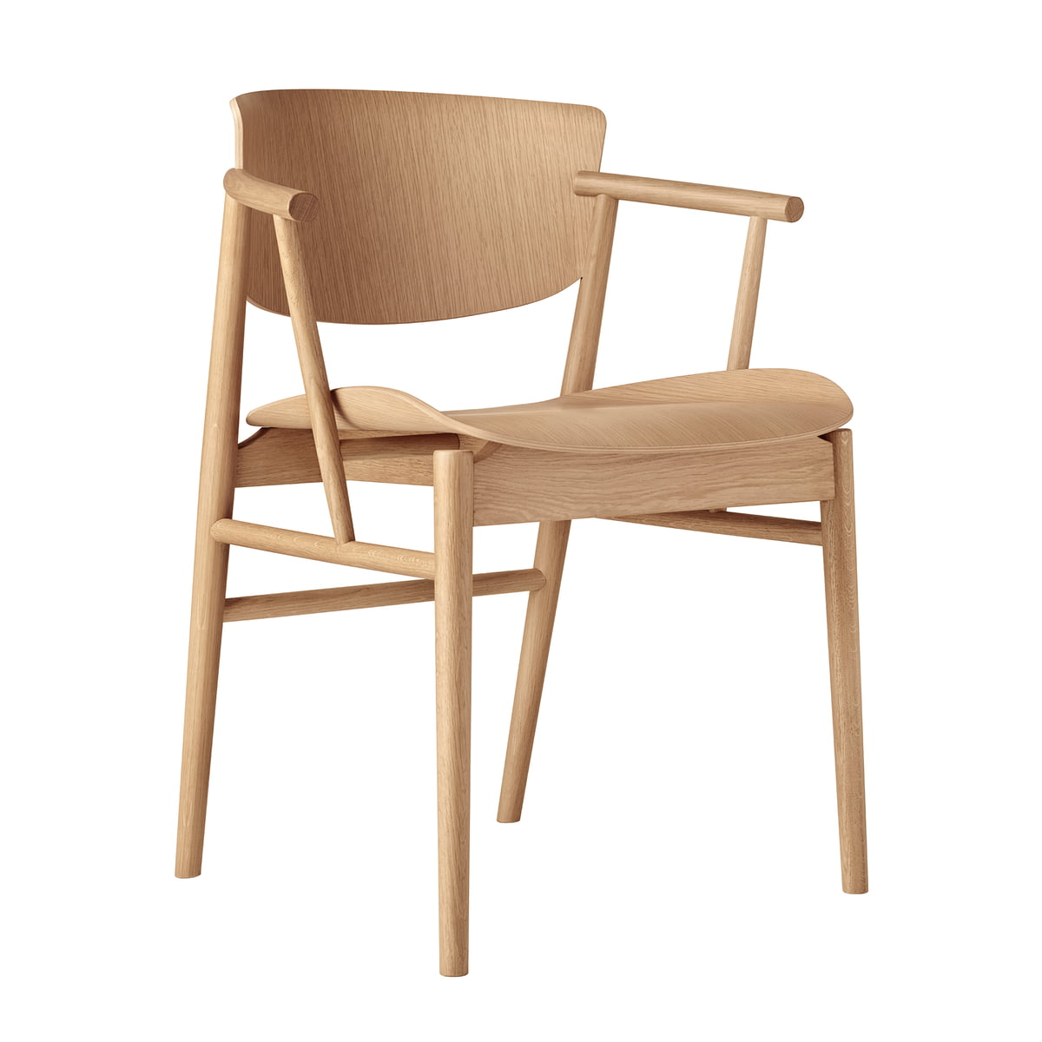
Mechanical properties of materials
Mechanical properties are associated with how a material reacts to an external force
Compressive strength: the ability to withstand being crushed or shortened by pushing force (compression)
Torsional strength: the ability to withstand twisting forces from applied torque or torsion
Tensile strength: the ability to resist stretching or pulling force (tension)
Hardness: the ability to resist abrasive wear
Bending strength: the ability to resist forces that may bend the material
Toughness: the ability to absorb impact force without fracture
Shear strength: the ability to resist sliding forces on a parallel plane.
Plasticity: the ability to be permanently deformed and retain the deformed shape

Slide 6
Physical properties of materials
Physical properties are associated with the actual make up or structure of the material. These properties include
Density: the mass of the material in a standard volume of space.
Fusibility: the ability of the material to be fused or converted from a solid to a liquid or molten state, usually by heat. Good fusibility is an essential property for a metal being cast
Corrosion/degradation resistance: the ability of the material to withstand environmental attack and decay
Magnetism: the natural force between objects that causes the material to attract iron or steels.

Slide 7
Electrical and thermal properties
Electrical and thermal properties may be the easiest to know and remember. From science lessons understanding how the two can impact a material can be quite simple.
Electrical conductor: allows the flow of electrical current through the material. A good conductor gives a very little resistance to the flow of charge
Thermal conductor: allows the transfer of heat energy through the material. A material with high thermal conductivity allows the transfer of heat to occur quickly across the material.
Electrical insulator: does not allow the flow of electricity through the material
Thermal Insulator: prevents the transfer of heat through the material
Thermal expansion: the increase in material volume in response to heat input.

Slide 8
Optical properties
Opaque: prevents light from travelling through
Translucent: allows light through but diffuses the light that objects appear blurred; frosted glass is an example of a translucent material.
Transparent: allows light to pass through easily, which means you can see clearly through the material
Exam tip
When answering questions that ask about the material properties of a product, use the correct term and justify why the property is needed – for example, acrylic is used for car headlight covers as it is transparent; this allows the light to shine through and illuminate the road for the driver.

Slide 9
Now test yourself
Define what is meant by the term ‘mechanical property’
Define what is meant by the term ‘physical property’
Name and define three types of mechanical strength properties
Give three material properties and state why each is required for a single-use drinks bottle made from a polymer
Explain why a workshop drill bit needs to be made from a hard material.
Typical mistake
Don’t make unjustified statements using generic terms such as ‘strong’. Use technical vocabulary with specific reasons related to the product.

