Slide 1
3. Methods for investigating and testing materials

Slide 2
Starter
0:00
0:01
0:02
0:03
0:04
0:05
0:06
0:07
0:08
0:09
0:10
0:11
0:12
0:13
0:14
0:15
0:16
0:17
0:18
0:19
0:20
0:21
0:22
0:23
0:24
0:25
0:26
0:27
0:28
0:29
0:30
0:31
0:32
0:33
0:34
0:35
0:36
0:37
0:38
0:39
0:40
0:41
0:42
0:43
0:44
0:45
0:46
0:47
0:48
0:49
0:50
0:51
0:52
0:53
0:54
0:55
0:56
0:57
0:58
0:59
1:00
1:01
1:02
1:03
1:04
1:05
1:06
1:07
1:08
1:09
1:10
1:11
1:12
1:13
1:14
1:15
1:16
1:17
1:18
1:19
1:20
1:21
1:22
1:23
1:24
1:25
1:26
1:27
1:28
1:29
1:30
1:31
1:32
1:33
1:34
1:35
1:36
1:37
1:38
1:39
1:40
1:41
1:42
1:43
1:44
1:45
1:46
1:47
1:48
1:49
1:50
1:51
1:52
1:53
1:54
1:55
1:56
1:57
1:58
1:59
2:00
For 2 minutes, discuss on your tables and write in your book…
Discuss why materials would need to be tested before manufacturing?
STRETCH AND CHALLENGE
Why may have you seen these terms before? give examples

Slide 3


Learning Objectives
Understand how different materials can be tested
Explain how material testing can impact a material
Discuss the difference between workshop and industrial testing
L/O Understand how different workshop tools can be applied and impacted on a material

Slide 4
Material testing
Materials testing is used to help select the most appropriate material for a product or application.
When testing different materials, the tests must be comparable (fair)
Use the same size of material for each test
Make sure the environmental conditions are the same
Use the same testing equipment and technique (including force applied and position of force)
Use one person to take all test measurements
Exam tip
State the purpose of the test, accurately label and describe how the test is carried out fairly.

Slide 5
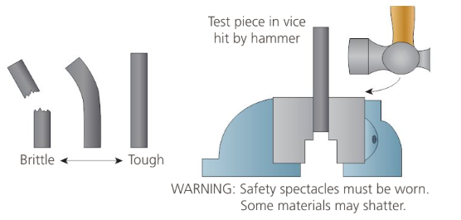
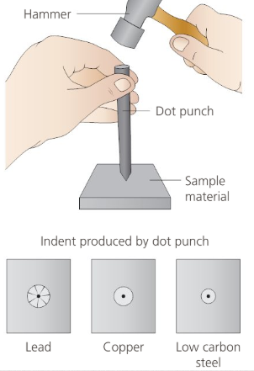
Simple workshop tests
Metals
Simple workshop tests use basic tools and equipment
Tensile, toughness, hardness, malleability and ductility tests are the main type of tests that can easily be performed in the workshop.
Less deflection under load means the material has more tensile strength
Toughness test: tough materials absorb impact, brittle materials bend or shatter
Hardness test: the material is tested using a dot punch and force with a hammer, the smaller the indent the harder the material
Malleability and ductility: when the test piece is bent to and angle of 90 degrees
cracks on the outside indicate a lack of ductility, cracks on the inside indicate lack of malleability.

Slide 6
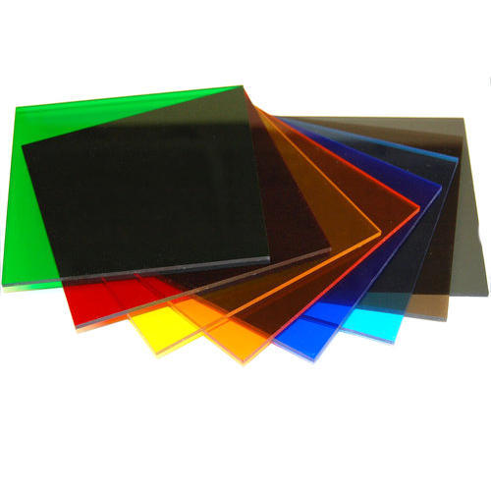
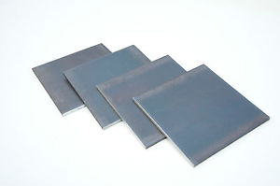
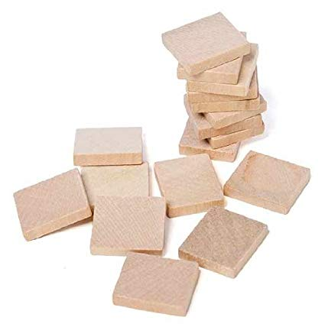
Simple workshop tests
Create a test in your books which has 3 of the materials tested with the different types underneath. Find out which material is best
Toughness test: tough materials absorb impact, brittle materials bend or shatter
Malleability and ductility: when the test piece is bent to and angle of 90 degrees
cracks on the outside indicate a lack of ductility, cracks on the inside indicate lack of malleability.
Hardness test: the material is tested using a dot punch and force with a hammer, the smaller the indent the harder the material

Slide 7
Other types of tests
Woods
Corrosion testing
Place equally sized material samples outside in an area exposed to the effects of weather and leave a set length of time.
Materials can then be visually inspected for surface corrosion
Electrical conductivity test
Collect material samples of the same dimensions and mark a set distance to place the multimeter probes. Measure the resistance on the multimeter. The higher the resistance the lower the conductivity
Typical mistake
Don’t describe an industrial testing method when a workshop testing method is asked for and remember to explain how the test results are interpreted.

Slide 8

Industrial testing
Woods
Industrial tests are usually carried out in a lab with specific testing machinery, using standardised test pieces of materials.
Different industrial testing is used for a variety of different materials, knowing the difference between workshop test and industrial tests may be important for your exams.
The video shown discusses certain types of tests that are important to
understand and remember for your exam.
As part of your understanding I want you to research and investigate the two different types of industrial testing as part of your home learning. Research the two testing aspects and produce a 500 word document on them
The Izod impact test
A tensometer machine

