Slide 1
SI Units & Ohms Law
Year 10 Electronics
Mr Wright

Slide 2
Prefix Multipliers
1,000,000,000,000
1 Tera (T)
10¹²
1,000,000,000
1 Giga (G)
10⁹
1,000,000
1 Mega (M)
10⁶
1,000
1 Kilo(K)
10³
1
0.001
1 milli (m)
10⁻³
0.000001
1 micro (µ)
10⁻⁶
0.000000001
1 nano (n)
10⁻⁹
0.000000000001
1 pico (p)
10⁻¹²

Slide 3
SI Units
Voltage Volts
Current Amps
Resistance Ohms
Capacitance Farads
Time Seconds
Frequency Hertz
Power Watts
Charge Colombs
Energy Joules

Slide 4
Ohms Law
The most important equation you will ever learn in electronics
V = IR
V = voltage (Volts)
I = current (Amps)
R = resistance (Ohms)
V
I
R

Slide 5
Some Exercizes
V
I
R
What voltage must be applied to a 2kΩ resistor in order for a 10mA current to flow ?
A coil has a current of 50 mA flowing through it when the voltage is 12 V. What is the resistance of the coil?
A 100 V battery is connected across a resistor and causes a current of 5mA to flow. Determine the resistance of the resistor.

Slide 6
What Else Does Ohm’s Law Tell us?
Rule 1:
A resistor with a current flowing through it will always have a voltage drop across it
Example
The light bulb demands 50mA
In the left hand circuit it has 9V across it & its demand is met
If I insert a 220Ω resistor in series with the light bulb :
What current flows through the resistor ?
What current flows through the light bulb
3. what voltage does the light bulb see now
+9V
+9V
R = 220Ω
X
50mA
X
50mA
0V
0V

Slide 7
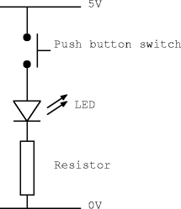
Rule 1: Example 2
V
I
R
The LED will blow up if it sees more than 15mA
The LED has a voltage drop of 1.5V
The power supply is +5v
So what happens to the other 3.5V ?
What is the value of the resistor ?

Slide 8
Rule 2:
V
I
R
A current cant exist without a voltage
I = V/R
If V = 0, then the value of R is irrelevant
I will always = 0 (NOTHING DIVIDED BY SOMETHING IS ALWAYS NOTHING)
So if any part of your circuit cant see a voltage – it wont work !

Slide 9
Rule 3:
V
I
R
The higher the resistance, the lower the current
Resistors limit current

Slide 10
Rule 4:
V
I
R
The lower the resistance the lower the voltage drop

Slide 11
Potential Dividers
Potential Divider Simulator
The fact that resistors drop voltage across them can be used to create fractions of the supply voltage
Vs
R1
R2
Vo
0V

Slide 12
Why Might I Want One ? (What use are they ?)
If I have 9v supply (for example):
I might want 5v to drive part of my chip
I might want just 1v to drive a transistor
I could use a second supply at a different voltage but deriving a lower voltage from the primary supply is more efficient

Slide 13
Example 1
Resistors R1 & R2 are equal
Each will drop the same amount of voltage
The voltage seen at the output is exactly half the supply

Slide 14
Example 2
R2 is 2x bigger than R1
R2 will drop 2x more voltage than R1
The voltage seen at the output is 2/3 of supply

Slide 15
Its all about ratios !
If supply voltage = 9V and R1 =2k and R2 = 1k, R2 will drop half as much voltage as R1
The voltage seen at the output is 3v
If supply = 12V and R1 =2K and R2=1k, the output voltage will be ????
Vo = Vs R2 / (R1 + R2)

Slide 16
Remember
The bigger the resistor, the bigger the voltage drop
Output voltage is always measured between 0V and the connection point of R1 & R2
What is difference between:
A: supply = 9V, R1 = 1K, R2=2K
B: supply = 9V, R1 = 100Ω, R2 = 200Ω

Slide 17
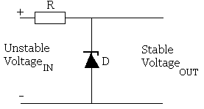
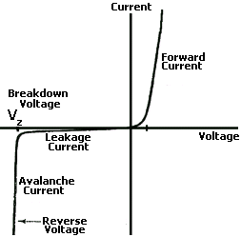
Other ways of controlling voltage
The zener diode
This conducts only when the voltage accross it reaches a certain voltage

Slide 18
DC Average Power
P
I
V
How much energy is transferred in a unit of time
Burned or generated
Measured in Watts
Average power: P= IV
Things that affect how much power a circuit will use:
Supply voltage
Amount of time it is switched on for
Activity (amount of switching)

Slide 19
Why Is Power Important ?
Burning energy generates heat
If I have a resistor with 9V across it and 100mA flowing through it, I will burn 0.9 W
Resistors come in different power ratings
Higher values are:
Physically bigger
Can dissipate more heat
Cost a lot more
If your resistor cant handle the power of your circuit, it will melt & fail
Most resistors in school are 0.25W, 0.5W or 0.6W
Metal film / carbon
Higher values (1W, 5W etc) are available
Wire wound

