Slide 1
St. Gregory’s
‘Caught Reading’ Advent Calendar 2021
Can you guess which member of staff has been caught reading?
There is one picture per school day of December.
Return your completed entry form to Dr McCooey-Heap on the last day of term for a prize!

Slide 2
1
HINT: This person’s name can be found within SNOWMAN

Slide 3
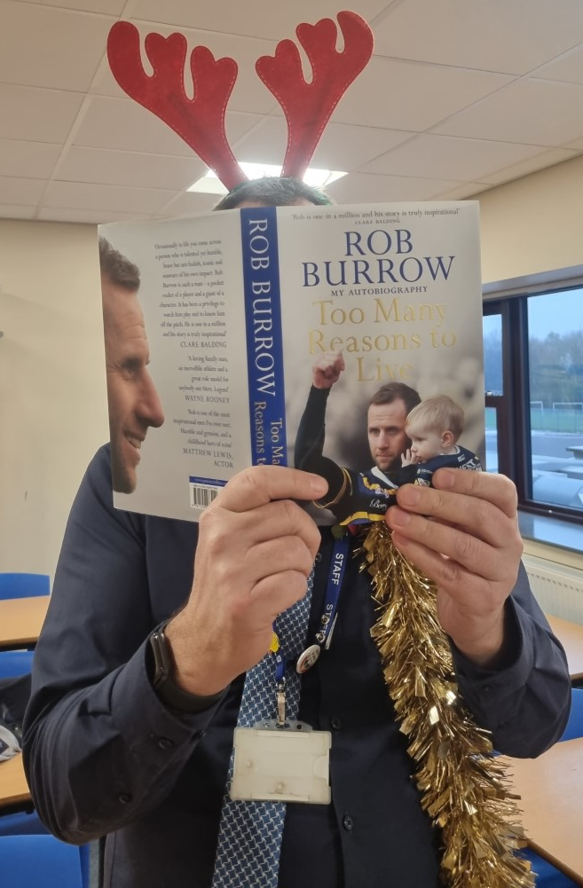
2
HINT
m +

Slide 4
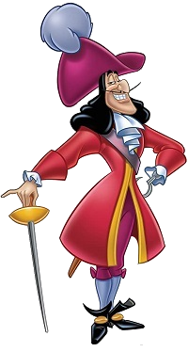
3
HINT

Slide 5
4
HINT: This person is usually found with Charles Dickens

Slide 6
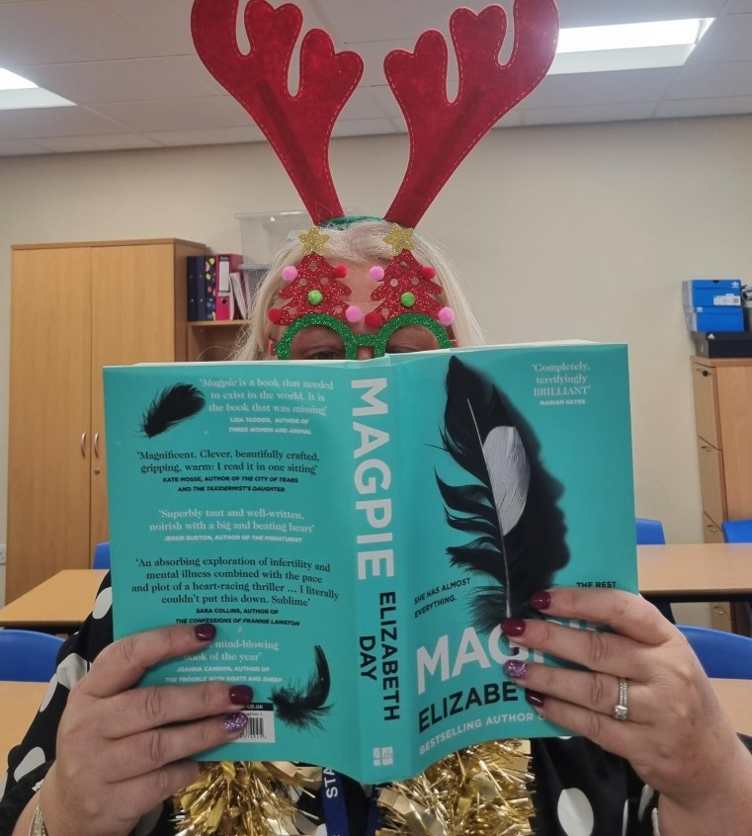
5
HINT: This person’s name is found in ANTLERS

Slide 7
6
HINT: This person’s name features on a famous space centre

Slide 8
7
HINT: This person’s name features in the title of a famous novel by Malorie Blackman

Slide 9
8
HINT: Famous people who share this person’s name include Francis and Kevin

Slide 10
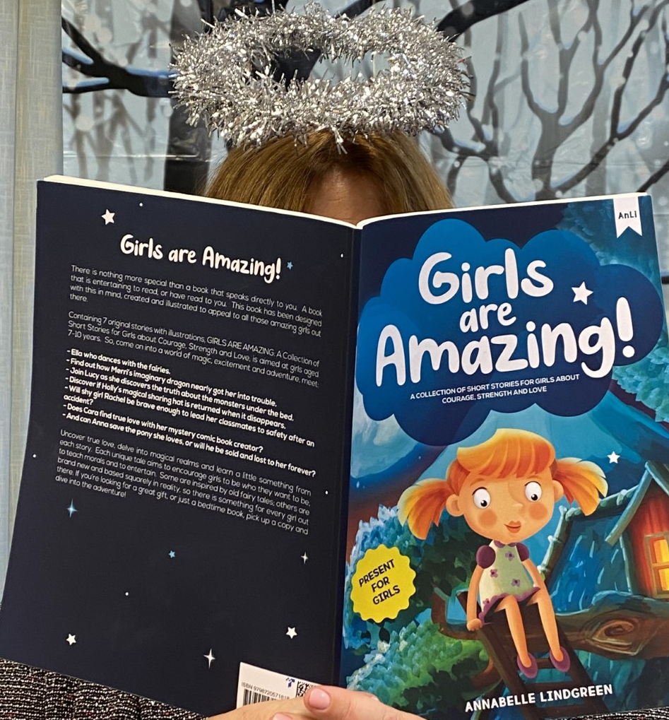
9
HINT: Unscramble the name –
SVIIMNASL

Slide 11
10
HINT: This person’s name is found in
OPEN SLEIGH

Slide 12
11
HINT: Famous glass manufacturers

Slide 13
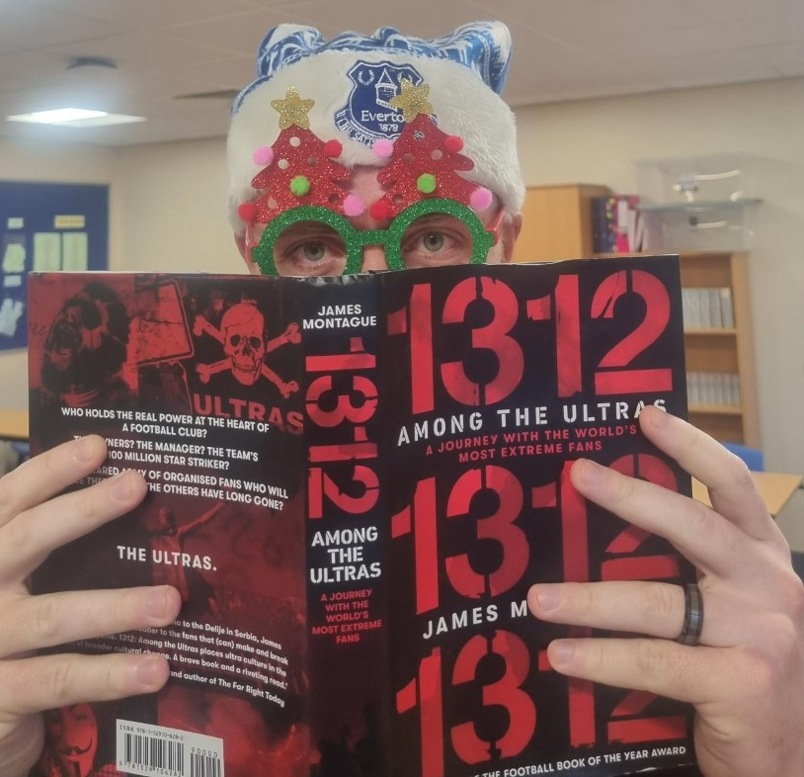
12
HINT: This person’s name is found in ANGEL

Slide 14
13
HINT:

Slide 15
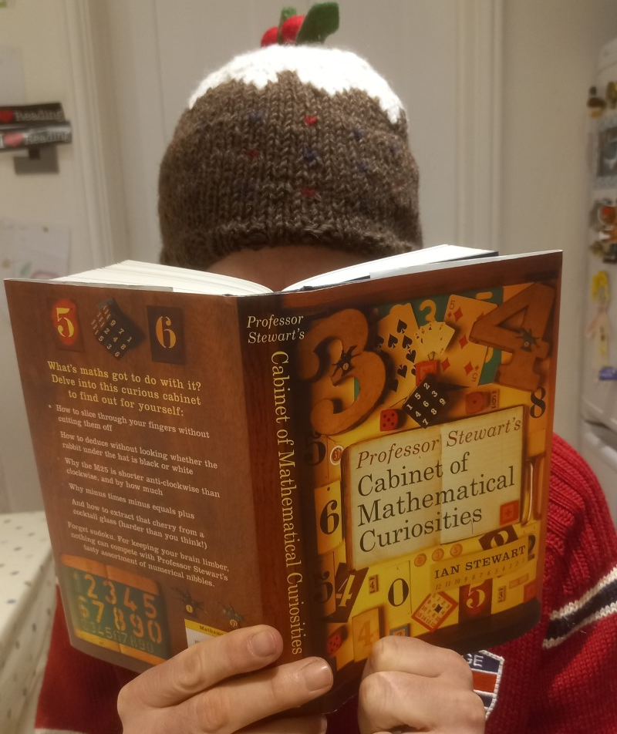
14
HINT:
Crack the code:
10 15 8 14 19 15 14

Slide 16
15
HINT:
This person’s name is found in CAROLLERS

Slide 17
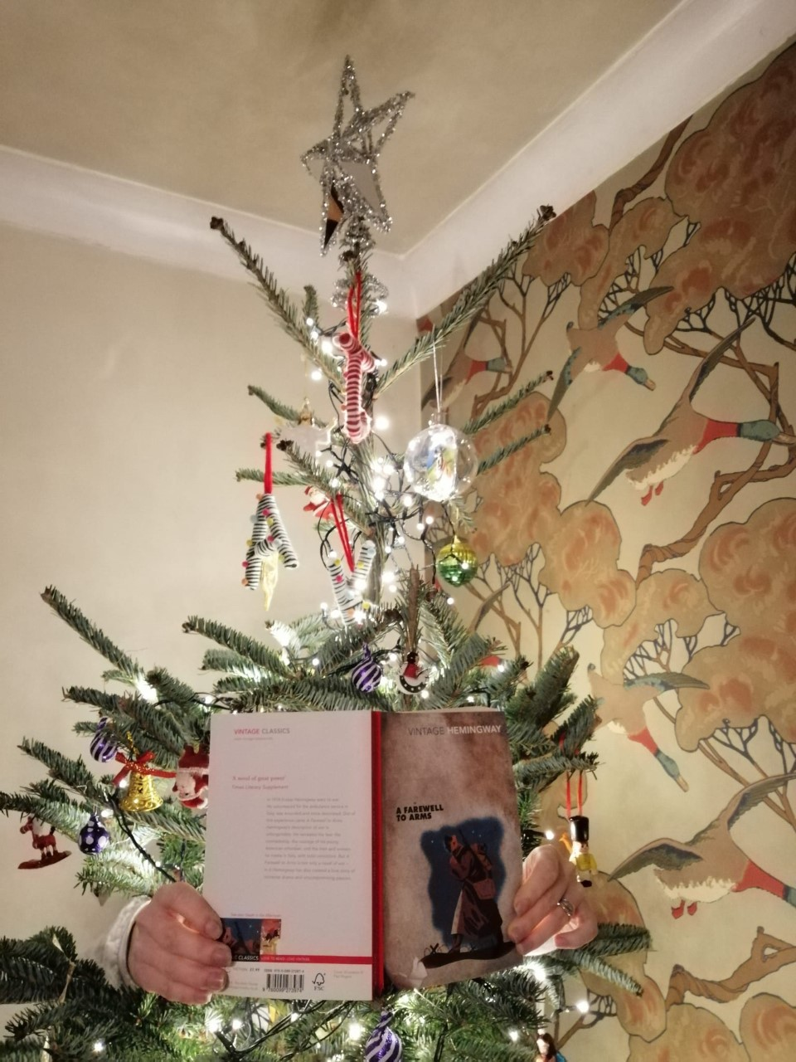
16
HINT: Crack the code
13 3 3 15 15 5 25 – 8 5 1 16

