Slide 1

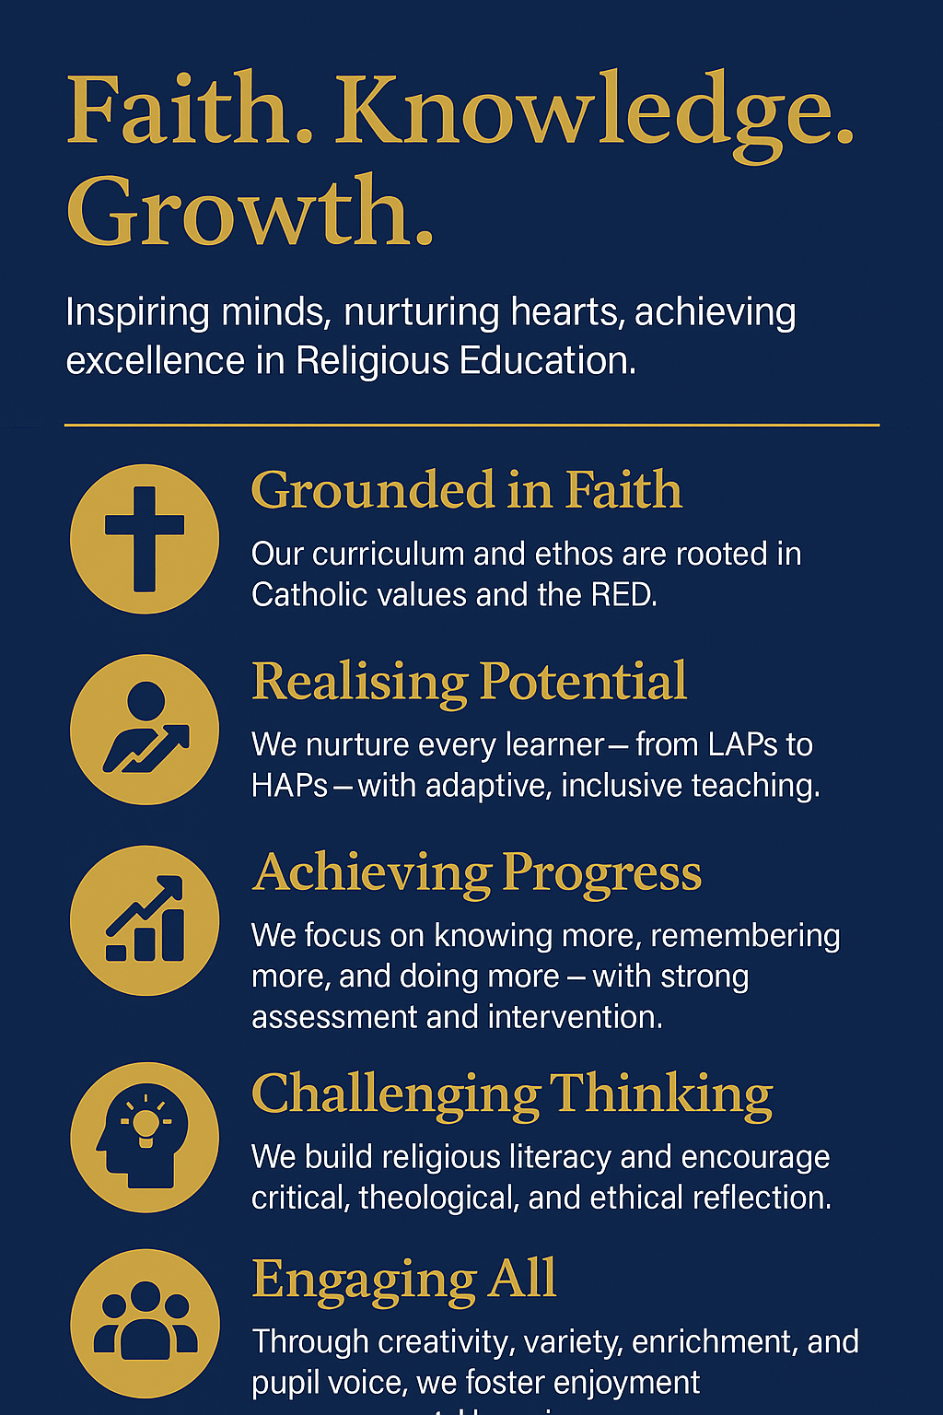

RELIGIOUS EDUCATION
“Faith. Knowledge. Growth.” Inspiring minds, nurturing hearts, achieving excellence in Religious Education through ‘GRACE’.
G - GROUNDED IN FAITH
Our curriculum and ethos are rooted in Catholic values and the RED.
R - REALISING POTENTIAL
We nurture every learner with adaptive, inclusive teaching.
A - ACHIEVING PROGRESS
We focus on knowing more, remembering more, and doing more – with strong assessment and intervention.
C - CHALLENGING THINKING
We build religious literacy and encourage critical, theological, and ethical reflection.
E - ENGAGING ALL
Through creativity, variety, enrichment, and pupil voice, we foster enjoyment and meaningful learning.

