Slide 1
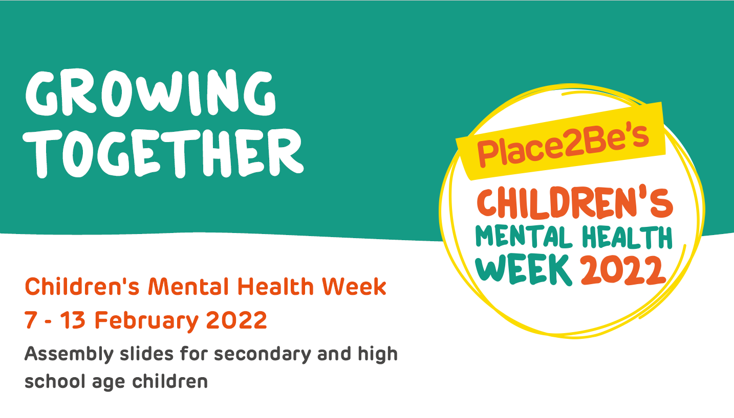

Slide 2
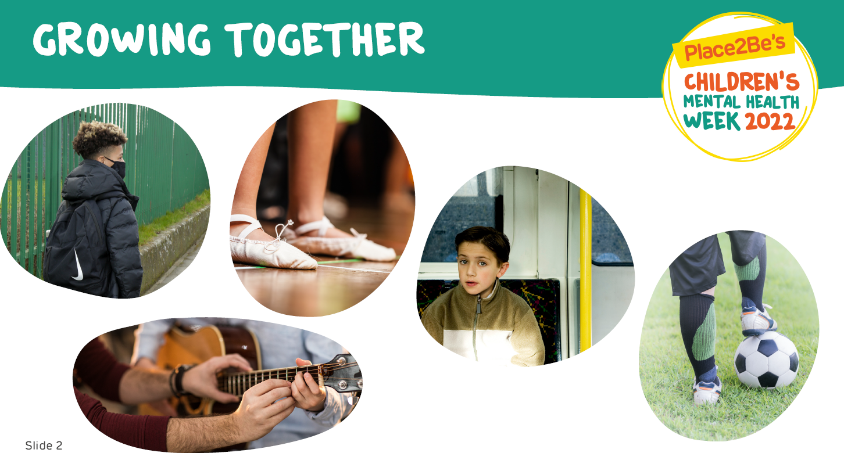

Slide 3
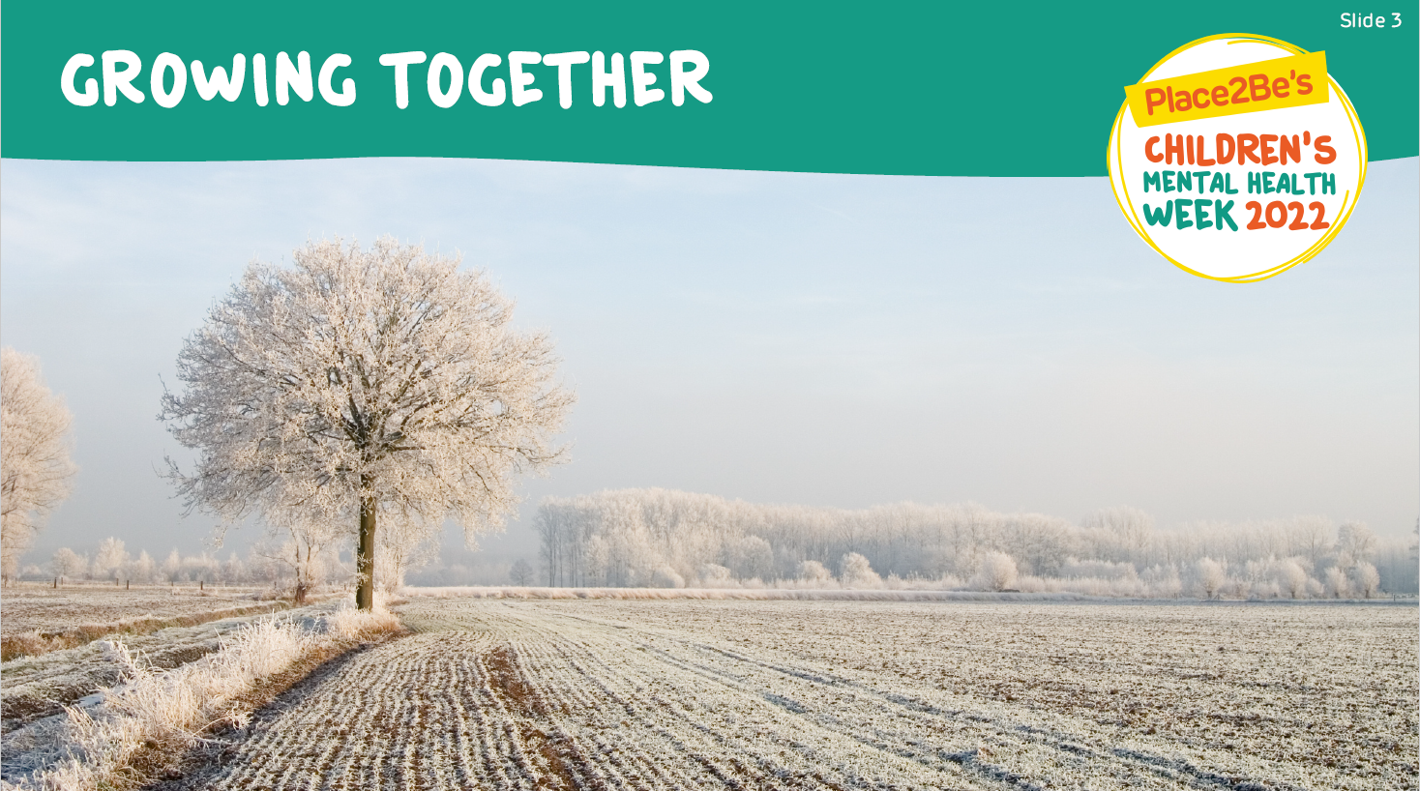
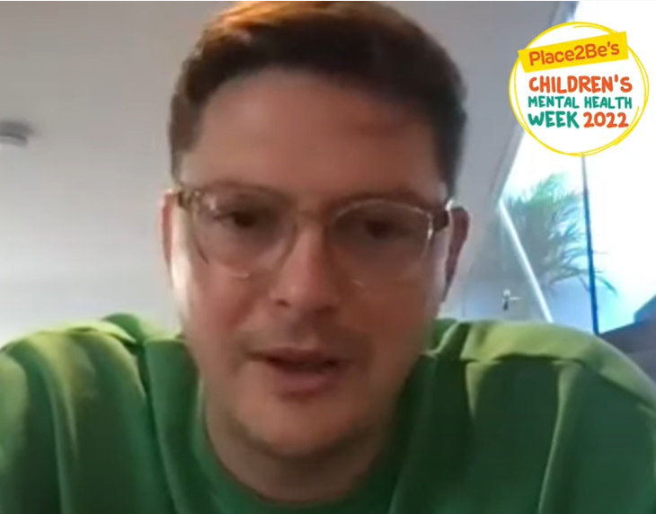
Dr Alex George's Growth Story teaser | Children's Mental Health Week 2022 - YouTube

Slide 4
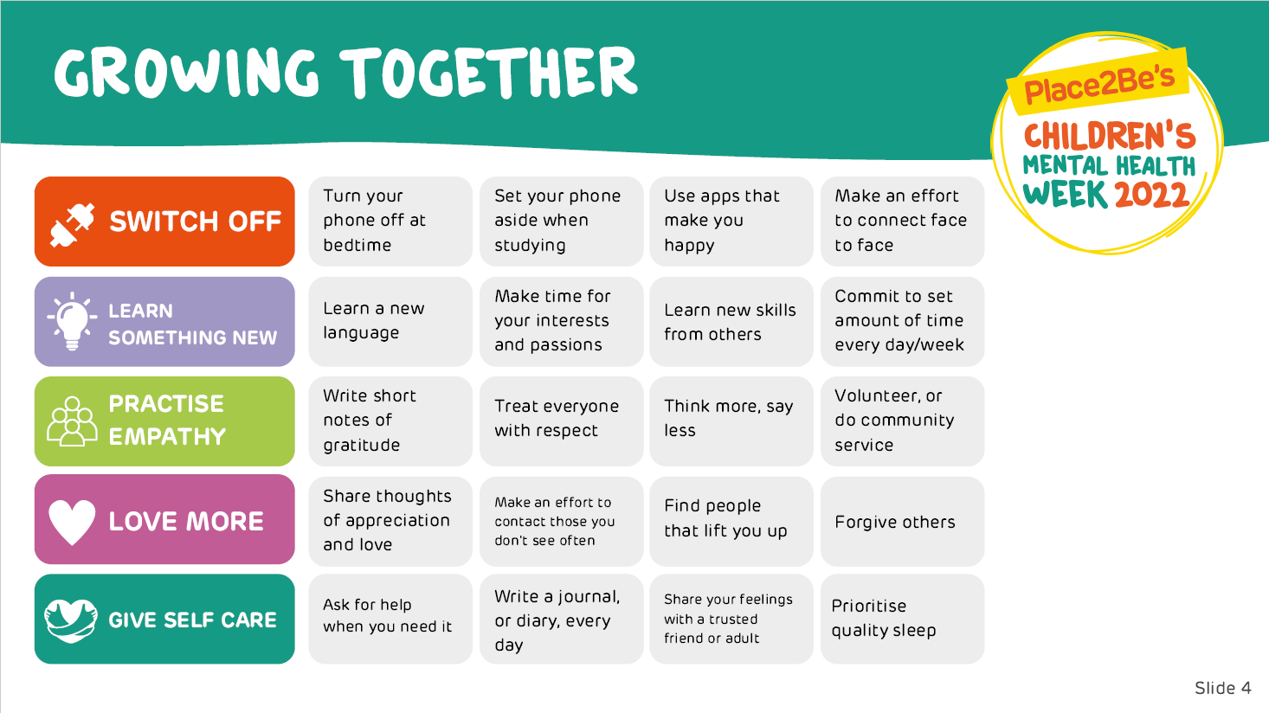

Slide 5
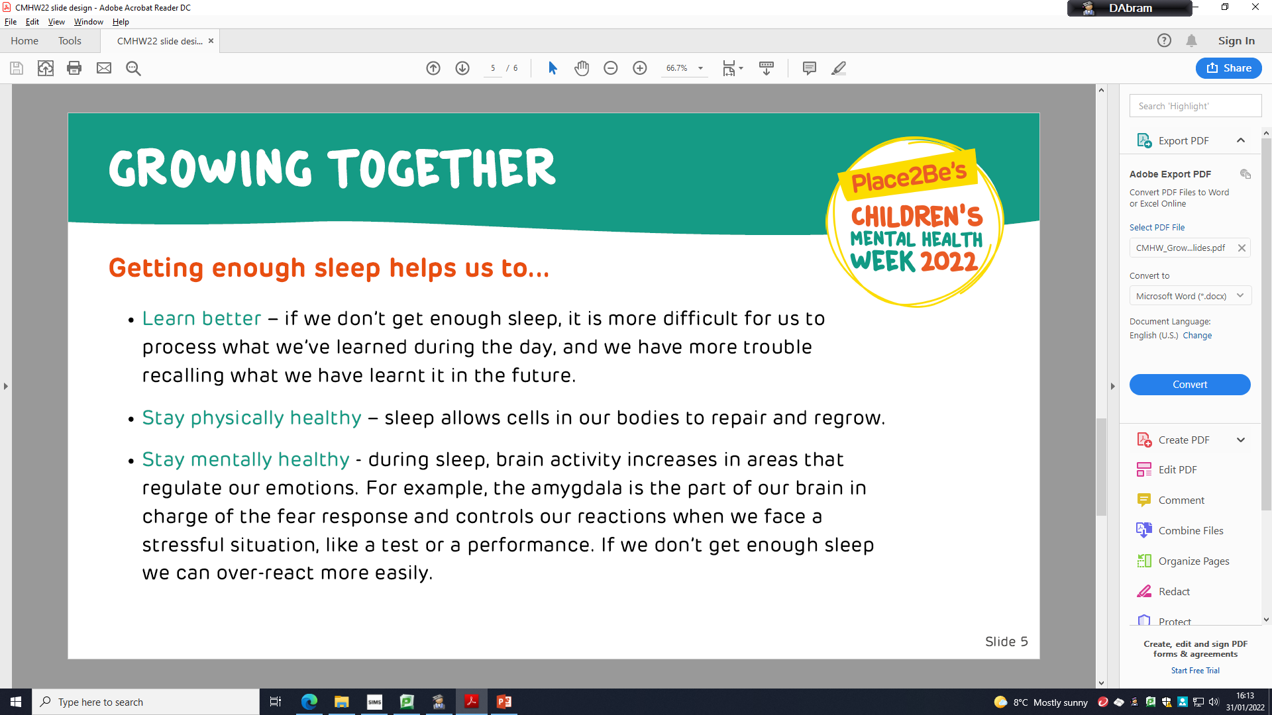

Slide 6
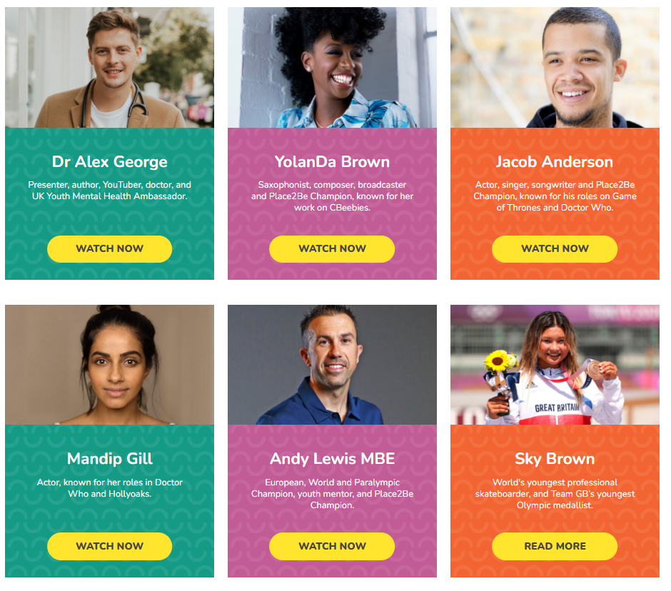
Other growth videos are available on the Children's Mental Health Week website, there will also be a link to this website all week on class charts
Children's Mental Health Week (childrensmentalhealthweek.org.uk)

Slide 7
