Slide 1
Year 6 bridging activity - Geography

Slide 2
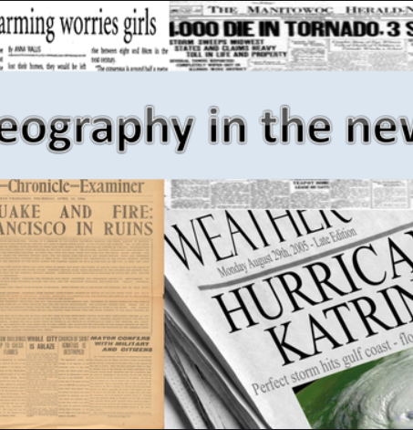
Challenge #1 – Geography in the news.
Keep a diary of Geography in the news. Where possible use pictures/headlines from the news and stick them into your diary.
Geography falls into three key areas of study:
Human (literally anything to do with humans and how they interact with the natural world is Geography)
E.g - farming, mining, deforestation, developing cities/towns, transport, tourism, economics, population change, disease, famine, war
Physical (the study of the natural world)
E.g - Rainforests, Oceans, Mountains, Rivers, Coasts, Cold environments, deserts, woodland, grasslands, weather & climate, flora & fauna, plant and animal adaptions.
Environmental (the impacts of humans on the environment)
E.g - Increased plastic use, pollution, climate change, deforestation, animal extinction, disease
Completing this activity will have a profound impact on your readiness for Geography in Year 7 🙂

Slide 3
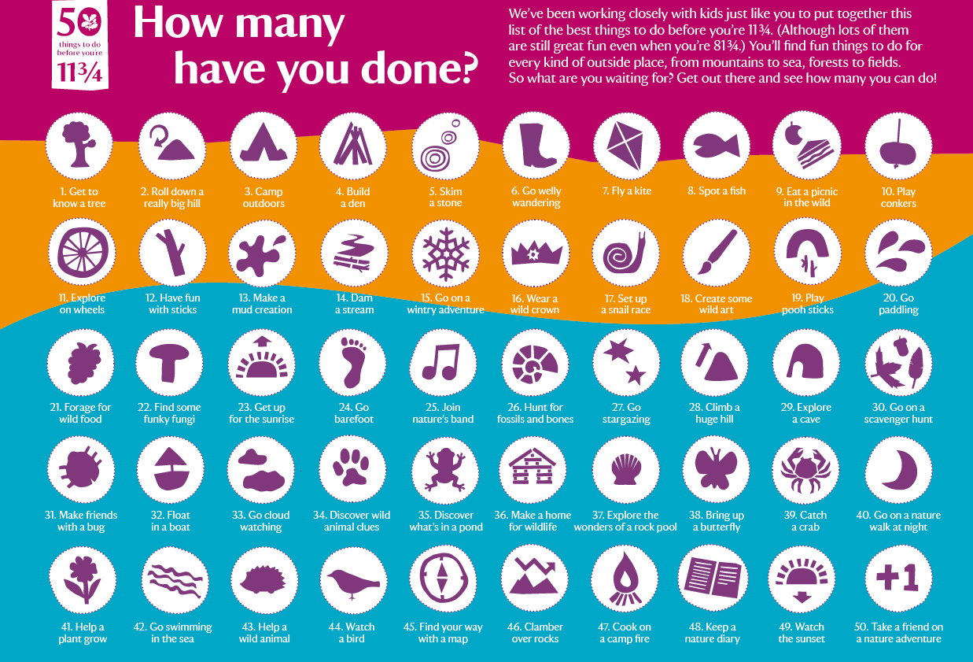
Challenge # 2

