Slide 1
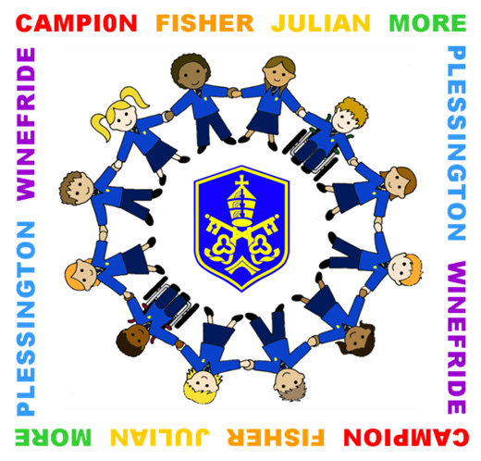
St. Gregory's
Catholic
High School
St. Gregory’s Catholic High School

Slide 2
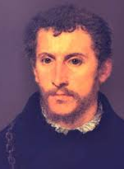
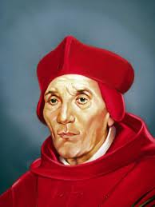
St. Gregory's
Catholic
High School
FORMS
7 Campion is named after St. Edmund Campion who was born into a Protestant family in 1540. He became a Catholic and at thirty-three, joined the Jesuits. He was executed as a traitor in 1581.
7 Fisher is named after St. John Fisher who was born in 1469 and studied theology at Cambridge University. He was appointed Bishop of Rochester and became a cardinal in 1535 whilst in prison awaiting execution.

Slide 3
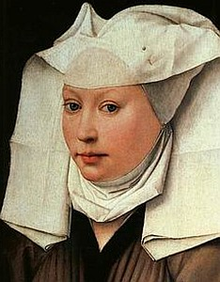
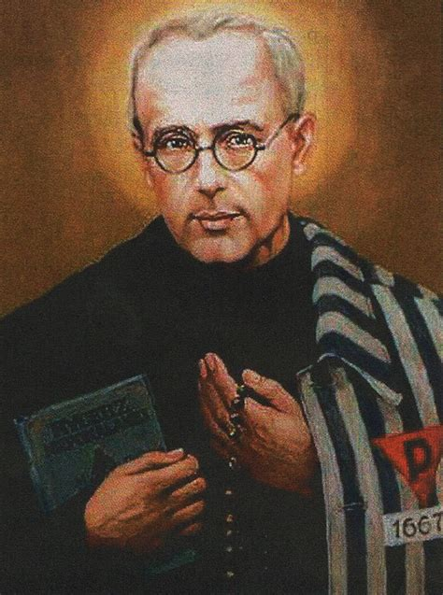
St. Gregory's
Catholic
High School
FORMS
7 Julian is named after Blessed Julian of Norwich. Born in 1342, she is famous for a vision she had of the sixteen understandings of the love of God in 1373. She then lived as an enclosed nun, praying, reflecting on her visions and counselling people who sought her help. Thousands still visit her shrine in Norwich each year.
7 Kolbe is named after Saint Maximilian Kolbe. He was a Polish Franciscan friar who volunteered to die in place of a stranger in the German death camp of Auschwitz, located in German-occupied Poland during World War II.

Slide 4
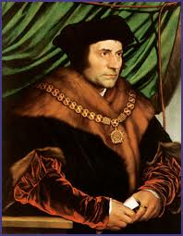
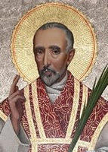
St. Gregory's
Catholic
High School
FORMS
7 More is named after St. Thomas More who was born in 1477. After studying at Oxford University, he married and had four children. King Henry VIII appointed him Chancellor of England. However, he gave up his wealth, position and eventually his life because although he was ’the King’s good servant’, he was ’God’s first’.
7 Plessington is named after St. John Plessington who was born at Dimples Hall, Garstang, which is not far from Warrington. He spent most of his life in the Chester area and was condemned to death at Chester Castle in 1679.

Slide 5
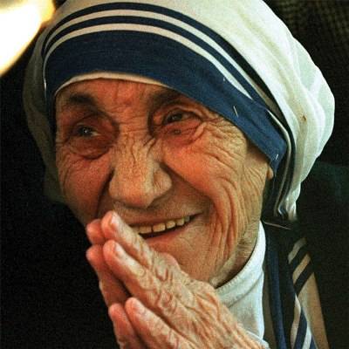
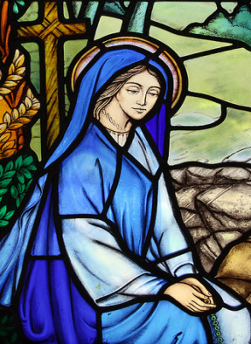
St. Gregory's
Catholic
High School
FORMS
7 Teresa is named after Saint Teresa of Calcutta, an Albanian-Indian Roman Catholic nun and missionary. She lived and worked with the poor of India and founded the Order of the Missionaries of Charity, a Roman Catholic congregation of women dedicated to helping the poor. She was considered to be one of the Twentieth Century's greatest humanitarians.
7 Winefride is named after St. Winefride. She lived in Holywell where she spent her life in prayer. She was Abbess in charge of her convent. After her death, Holywell became an important centre for pilgrimage.

Slide 6
St. Gregory's
Catholic
High School
THE SCHOOL DAY
8.00 | LRC open
8.45 | Movement Bell/ Drama Theatre for Year Group Collective Worship
8.50 | Registration (or Collective Worship)
9.05 | Period 1
10.05 | Period 2
11.05 | Break
11.20 | Movement Bell
11.25 | Period 3
12.25 | Period 4/ First Lunch
1.00 | Period 4
1.25 | Period 4/ Second Lunch
1.55 | Movement Bell
2.00 | Period 5
3.00 | Dismissal. LRC open. Extra-Curricular Activities
4.00 | LRC Closed. Extra-Curricular Activities finish.
Please Note: Pupils will be marked late if they arrive after 8.50 a.m.

Slide 7
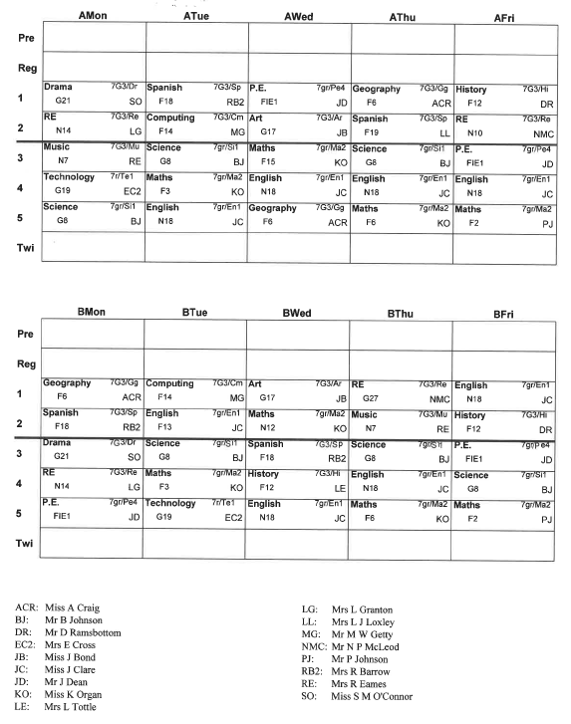
St. Gregory's
Catholic
High School
AFTER THE FIRST DAY
Talk to your child about their timetable
Note the days when they need specialised equipment e.g. PE kit/ technology materials.
EXAMPLE

Slide 8
St. Gregory's
Catholic
High School
AFTER THE FIRST DAY
Read through your child’s learning organiser and become familiar with the way it should be used effectively by your child and yourself.
Please check your child’s learning organiser on a daily basis to monitor progress with ‘My Progress Tracker’
Help your child to fill in the Personal Development Record including Contribution to school life
Homework will be recorded on ClassCharts

Slide 9
St. Gregory's
Catholic
High School
HOMEWORK
Our Homework Policy ensures your child develops the skills essential for your future learning - college, university, the world of work.
Purpose:
To extend the learning beyond the classroom experience
To consolidate on and confirm the learning in school
To prepare for the next lesson
To develop the confidence needed to become an independent learner.

Slide 10
St. Gregory's
Catholic
High School
HOMEWORK
Your child will be given a homework timetable which is recorded in the back of the Learning Organiser
The homework will be posted on ClassCharts
Check your child is recording homework on a daily basis.
Initially, spend time helping your child organise and complete their homework on the day it is set so that an efficient routine is established

Slide 11
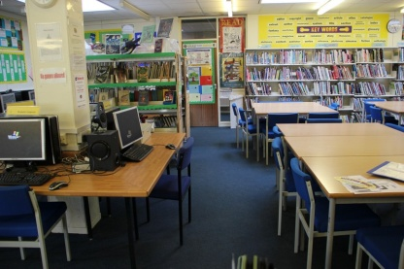
St. Gregory's
Catholic
High School
HOMEWORK
Check your child has completed their homework and it is packed for the relevant lesson and due day.
Make homework a positive experience by praising your child when they complete it early in the evening
Remember that your child has access to the Learning Resource Centre before and after school, and at break time and lunchtime if they wish to do some homework there

Slide 12
St. Gregory's
Catholic
High School
SCHOOL UNIFORM
Boys Royal blue blazer with badge Lower School Blue shirt (Tucked in) School tie: 6 stripes visible (Top button fastened) Upper School White shirt (Tucked in) School Tie: School badge visible (Top button fastened) Black formal trousers (No jeans/cord/denim/ skinny/tight fit trousers) Plain black socks | Girls Royal blue blazer with badge Lower School: Blue revere neck blouse (Tucked in) Upper School: White revere neck blouse (Tucked in) Black formal trousers or knee length badged school skirt Knee/ankle length Plain black socks or tights. No ‘over the knee’ or trainer socks

Slide 13
St. Gregory's
Catholic
High School
SCHOOL UNIFORM
Jumper (optional): if worn must be school badged jumper Shoes: Formal black leather, flat heeled, no extremes of style. Boots, canvas shoes, trainers are not permitted. Outdoor Coats/Jackets: Suitable style for school wear and be removed when in the school building. Fashion/leather/denim jackets are unacceptable. Headscarves – if worn, for religious reasons, must be plain black/dark blue
Jewellery: cross/chain/watch/one pair of plain stud earrings only Makeup: not allowed. No false eyelashes. Nails: no varnish, or false gel/ shellac/acrylic nails allowed Haircuts: no dyed/coloured/shaved/ridged/extreme styles Tattoos: no temporary tattoos/Henna designs on hands/legs are allowed

Slide 14
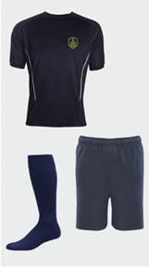
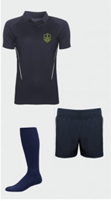
St. Gregory's
Catholic
High School
SCHOOL UNIFORM
PE Clothing (From September 2020)
Boys and Girls
Navy Sports Top (Badged)
Navy shorts (Badged)
Navy socks
Navy tracksuit (Badged) (Full tracksuit or individual items e.g. tracksuit top/ bottoms.)
Sports trainers (Pumps/converse style trainers are strictly not permitted in the interest of health and safety)
Studded boots for winter sports
Additional Equipment: Gum shields* Shin pads*
Boys Girls
*As recommended by Association for Physical Education (AFPE) in safety legislation.
Uniform Suppliers
Touchline School Wear Tel: 01925 413777
Warrington School Wear Tel: 01925 576868

Slide 15
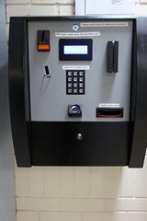
St. Gregory's
Catholic
High School
CASHLESS VENDING
Main Benefits
Convenient way of paying for school meals. No more looking for change every morning.
Queuing times are reduced through increased speed of service.
Automatic free meal allocation with the pupil remaining anonymous.
A more efficient delivery of service helps the caterer to provide wholesome, healthy and enjoyable school meals at a low cost.
Add money to your child’s account by the School Gateway App or cash machine in school

Slide 16
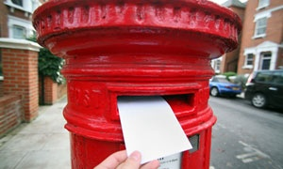
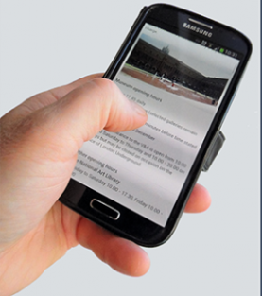
St. Gregory's
Catholic
High School
COMMUNICATIONS
With CLASSCHARTS App
With Subject Teachers – by letter or by making a note in the comments section of Learning Organiser
With the Form Tutor – by letter
With the Pupil Progress Manager– by letter or telephone via the Pastoral Office

Slide 17
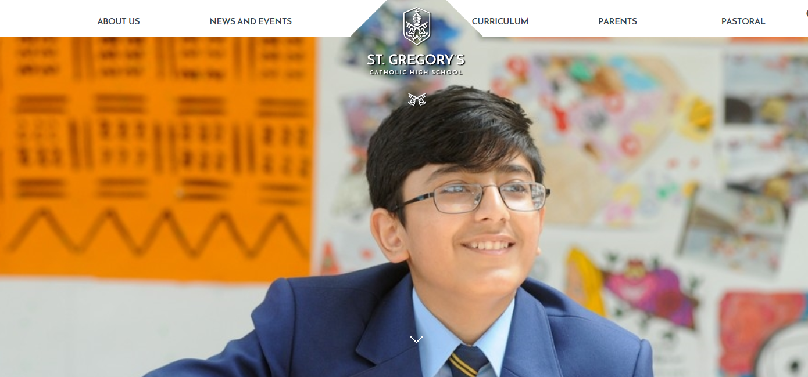
St. Gregory's
Catholic
High School
COMMUNICATIONS
School will contact parents
Letters home with pupils (available on school website)
Texting service (remember to tell school if your mobile number changes)
Information on the school website
www.stgregoryshigh.com

