Slide 1
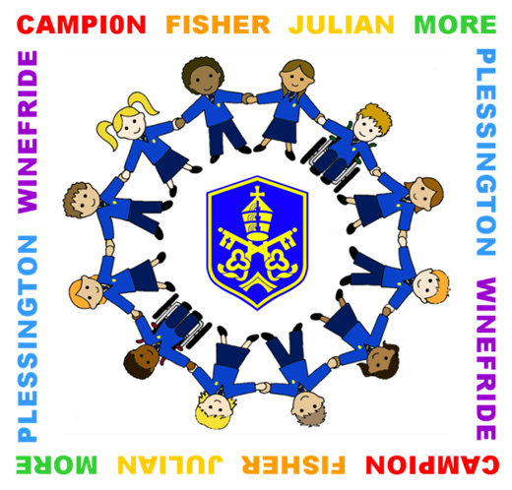
St. Gregory's
Catholic
High School
St. Gregory’s Catholic High School

Slide 2
“Pupils at St. Gregory’s are happy, confident and welcoming to visitors. They like each other.”
Ofsted Inspection Report
January 2020

Slide 3
“There is a strong sense of community across the school. This reflects the school vision, ‘one family, inspired to learn’ One pupil said: ‘We are cared about as individuals but, because everyone cares, that makes us all one’”
Ofsted Inspection Report
January 2020

Slide 4
“Pupils are actively encouraged to understand, appreciate and respect difference in the world and its people…..there is a well-planned curriculum for pupils’ development”
Ofsted Inspection Report
January 2020

Slide 5
“Pupils with special educational needs and/or disabilities are well supported in their learning
Ofsted Inspection Report
January 2020

Slide 6
“the school library is an exciting place to be. There are a range of competitions and rewards to encourage pupils to read.”
Ofsted Inspection Report
January 2020

Slide 7
St. Gregory's
Catholic
High School
STARTING A NEW SCHOOL
Starting a new school is special and challenging in its own way.
Part of our aim is to:
give pupils the skills and the knowledge they need for lifelong learning.
introduce them to a wide range of subjects and studies.
make them more independent and self aware.
show them how to think and learn for themselves.
give them confidence to join in, ask questions, help others.
lay the foundations for success at GCSE and beyond.

Slide 8
St. Gregory's
Catholic
High School
BEFORE THE FIRST DAY
Ensure every article of uniform and PE kit has your child’s full name inside it, even their socks and shoes.
Read through all documents and policies with your child. Discuss with your child how they should wear their uniform, including our rules regarding hair styles, make up and jewellery.
Dedicate a place in the house for your child’s schoolwork, access to a well lit desk/ table and a box for storing books are crucial.
Ensure your child is fully equipped and has a suitably sized school bag.
Calculate what time your child needs to get up so they have time for breakfast and to get ready without rushing.
Talk through and trial run the journey to and from school.

Slide 9
“..the curriculum is well planned to provide aspiration for all pupils….Learning is planned in the right order. Pupils are able to build new learning on what they already know.”
Ofsted Inspection Report
January 2020

Slide 10
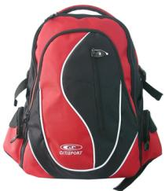
St. Gregory's
Catholic
High School
AFTER THE FIRST DAY
Establish a morning and evening routine and keep to it. In the evening a possible routine once home could be:
Change and hang up school clothes
Have a snack
Check Learning Organiser
Complete homework
Re-pack school bag for the following day
Teaching staff and form tutors will use the organiser to communicate information with you.

Slide 11
St. Gregory's
Catholic
High School
COLLECTIVE WORSHIP
Your child will have Collective Worship on Friday Mornings

Slide 12
“Pupils are safe in school. They say that there are many people that they can talk to if they have worries and concerns. Bullying is not tolerated”
Ofsted Inspection Report
January 2020

Slide 13
St. Gregory's
Catholic
High School
SAFEGUARDING
Our priority is ensuring all pupils are safe and happy.
We are a Listening and Telling school and there is a Safeguarding Team whom you can go to for help and advice.
Posters are displayed around the school with the names of our Safeguarding Team.
Take a look at the Safeguarding, Young Cares, Youth Health Champions, E-Safety Offices notice boards near the dining room for regular updates.

Slide 14
St. Gregory's
Catholic
High School
The School Help Advice Reporting Page (SHARP System) is designed to assist us with safeguarding young people across a whole range of issues. Pupils can make a confidential report to the school, and we can decide on appropriate action.
Pupil Health Support is run by the School Health Adviser. Pupils can make an appointment with them or attend drop in sessions:
Tuesday lunchtimes
in the St Francis of Assisi Room.

Slide 15
St. Gregory's
Catholic
High School

Slide 16
St. Gregory's
Catholic
High School
ATTENDANCE
The Importance of Attending School
A good education is essential
The attendance record will be provided as part of a school reference.
An exemplary attendance record is essential in the world of work so you need to get into good habits regarding attending and being on time.
Please report any absence before 8.30 a.m.
All pupils should be on site by 8.40 a.m.

Slide 17
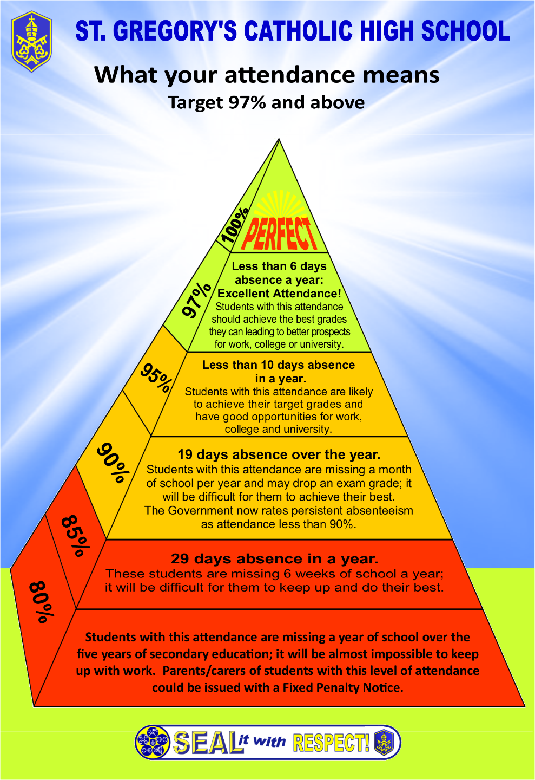
St. Gregory's
Catholic
High School

Slide 18
St. Gregory's
Catholic
High School
ATTENDANCE
Unauthorised Absences
Parents are reminded, that in line with Warrington LA policy, holidays in term-time will be recorded as unauthorised absence.

Slide 19
St. Gregory's
Catholic
High School
ATTENDANCE REWARDS
Attendance Awards
‘Well Done’ postcards are sent out to pupils with recognised improved attendance and punctuality
Chocolate treats are given each term for those with 100% attendance and no lates.
Pupils with 100% attendance throughout the whole school year are awarded a Gold Certificate.

Slide 20
Home-School Partnership
In order to achieve our aims the basis of our Home-School Partnership is for the school to:
Provide a Catholic education based on the example and teaching of Christ.
Provide a broad and balanced education.
Monitor your child’s progress and report on levels of achievement and their attitudes to learning.
Provide advice and guidance on the programmes of study which your child is following.
Be available should you have any concerns and to inform you if your child is experiencing any difficulties.
Provide regular opportunities for you to discuss your child’s progress with his/her teachers.
Operate a behaviour code to provide an ordered and safe community.
Keep you regularly informed of general school issues.
Use a range of forums to recognise and celebrate achievement and involvement.
St. Gregory’s would also wish to seek parents’ active interest in their child’s education by:
Ensuring their child’s regular attendance at school (97%).
Ensuring their child is in school by 8.40 a.m. at the latest.
Ensuring their child has the necessary equipment to access and support their learning.
Making sure that their child wears full school uniform and P.E. kit, adheres to jewellery/ make-up/ appearance rules.
Supporting the school’s homework policy and monitoring via Class Charts
Attending meetings relating to their child’s education including Engage Evenings.
Informing the school of any issues which may affect their school life/ general well-being.
Encouraging responsible behaviour on the journey to and from school, including on public transport.
Actively encouraging their child to take part in extra curricular activities.
Supporting all e-safety guidance/rules, including non use of mobile phones on school premises.
Supporting the school in its expectations of good behaviour and positive attitudes to all aspects of learning.
Supporting the school in the application of sanctions when wrong choices have been made.
Providing the school with up to date information regarding telephone numbers, email addresses, changes of address, emergency contacts, medical information etc.
St. Gregory's
Catholic
High School
HOME-SCHOOL PARTNERSHIP
This can be found in your child’s Learning Organiser.
Please make sure you and your child read and sign it.
I agree to support the home – school partnership | Pupil
 | Parent/Carer

Slide 21
St. Gregory's
Catholic
High School
REACH FOR THE STARS
We record and monitor both positive and negative behaviours.
Pupils earn extra points by a variety of positive actions
Outstanding Progress
Outstanding Effort
Consistently working to a high standard
Full/Improved attendance
Random Acts of Kindness

Slide 22
St. Gregory's
Catholic
High School
REACH FOR THE STARS
Making Wrong Choices
Lack of equipment
Late to lesson
Minor disruption
Failure to complete homework
Use of mobile phone

Slide 23
St. Gregory's
Catholic
High School
REACH FOR THE STARS
Continue to monitor your child’s progress in the Learning Organiser
Special rewards are given at the end of the autumn and summer term to youngsters who keep all their credits.

Slide 24
St. Gregory's
Catholic
High School
RESPECT CARD

Slide 25
St. Gregory's
Catholic
High School
ENGAGE EVENINGS
An opportunity to talk to teachers about your child’s progress
Form Tutor Evening (October)
Y7 Parents’ Evening (March)
School will contact you with the dates and times and all details will be on the school website.

