Slide 1
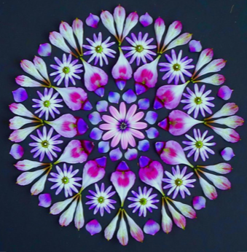
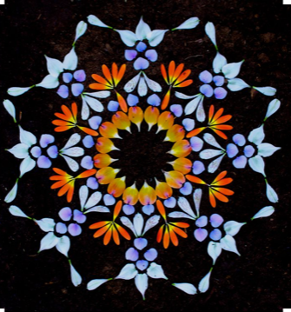
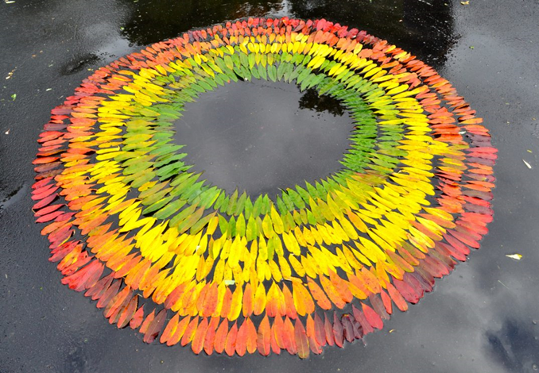
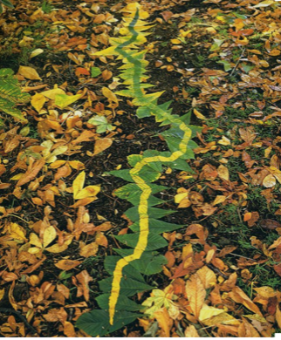
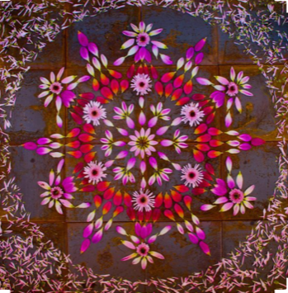
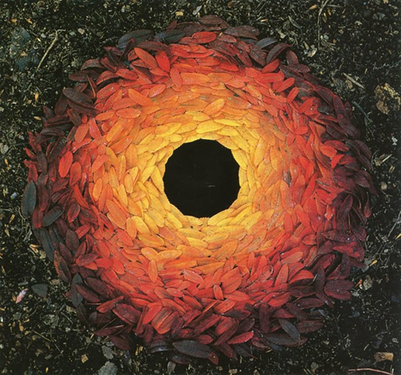
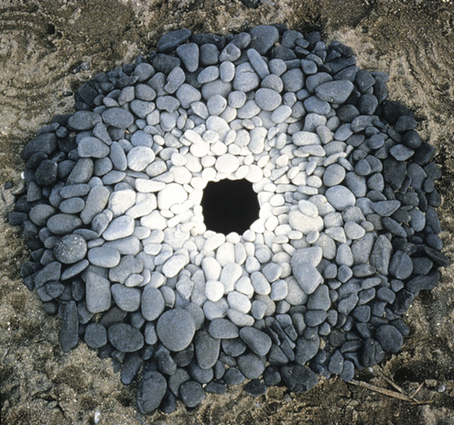
Task:
1. Research Artist Andy Goldsworthy or Kathy Klein
2. Collect some natural materials that are interesting colours, shapes and sizes.
3. Arrange your natural forms to create a unique piece of Art. Take a clear photograph.
Andy Goldsworthy is a British artist known for his site-specific installations involving natural materials and the passage of time.
Andy Goldsworthy is a naturalist, meaning that all of his art is derived from or related to nature. He is inspired by all aspects of the natural world, including snowflakes, twigs, icicles, reeds, tree roots, and rocks.
4. Draw a small section of your arrangement.
Kathy Klein is an American Artist. She creates beautiful mandalas using petals, seeds and other natural forms. Klein calls the arrangements her ‘danmalas’, can you find out why?

