Slide 1
St. Gregory's Catholic High School Physical Education Department Year Six - Transition Work
Anatomy and Physiology
Skeletal System
Muscular System
Name ............................................

Slide 2
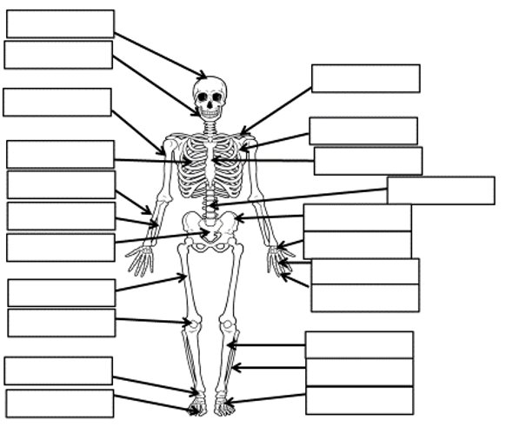
Skeletal System
Research and label the following bones of the skeletal system
-Cranium
- Mandible
- Humorous
- Radius
- Ulna
- Sacrum
- Femur
- Fibula
- Tibia
- Tarsals
- Phalanges
- Metatarsals
- Patella
- Phalanges
- Metacarpals
- Carpals
- Pelvis
- Vertebrae
- Sternum
- Scapula
- Clavicle

Slide 3
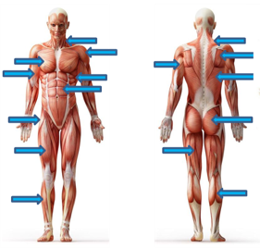
Muscular System
Research and label the following bones of the muscular system
- Pectorals
- Bicep
- Hip flexor
- Quadriceps
- Tibialis anterior
- Sternocleidomastoid
- Deltoid
- Intercostal muscles
- Abdominals
- Triceps
- Trapezius
- Rotator cuff
- Latissimus Dorsi
- Gluteal
- Hamstrings
- Gastrocnemius

