Slide 1
St. Gregory's
Catholic
High School
St. Gregory’s Catholic High School
Welcome to the St Gregory’s Family

Slide 2
St. Gregory's
Catholic
High School
THE SCHOOL DAY
8.00 | LRC open
8.40 | All pupils on site, staff and pupil movement bell rings
8.45 | Drama Theatre for Year Group Collective Worship
8.45 | Registration/ Collective Worship in Form
9.05 | Period 1
10.05 | Period 2
11.05 | Break
11.20 | Movement Bell
11.25 | Period 3
12.25 | Period 4/ First Lunch
1.00 | Period 4
1.25 | Period 4/ Second Lunch
1.55 | Movement Bell
2.00 | Period 5
2.55 | KS3 Dismissal. LRC open. Extra-Curricular Activities
4.00 | LRC Closed. Extra-Curricular Activities finish.

Slide 3
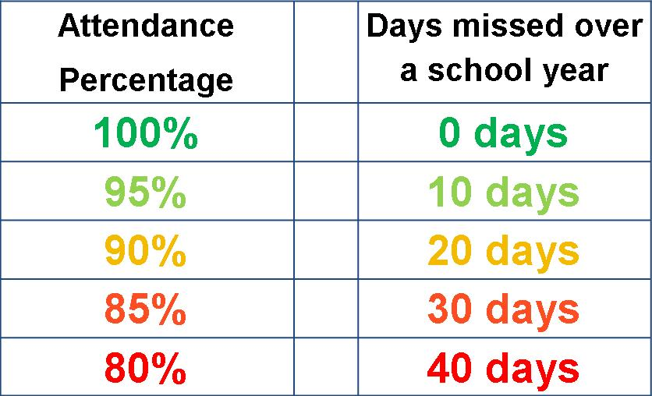
St. Gregory's
Catholic
High School
Attendance and Punctuality
All pupils to be on site no later than 8.40am every day
All pupils should strive to achieve 100% attendance
Communication will be made with home if attendance starts to drop
Primary information on attendance passed up to closely monitor pupils – mentoring.
Attendance is used towards end of term/year trips.

Slide 4
St. Gregory's
Catholic
High School
SCHOOL UNIFORM
Girls
Royal blue blazer with school badge
Lower School: Blue revere neck blouse Upper School: White revere neck blouse
Black formal trousers or knee length badged school skirt
Plain black socks or tights.
No ‘over the knee’ or trainer socks

Slide 5
St. Gregory's
Catholic
High School
SCHOOL UNIFORM
Boys
Royal blue blazer with school badge
Lower School Blue shirt (Tucked in)
School tie: 6 stripes visible (Top button fastened)
Upper School White shirt (Tucked in)
School Tie: School badge visible (Top button fastened)
Black formal trousers (No jeans/ cord/denim/skinny/tight fit trousers)
Plain black socks

Slide 6
St. Gregory's
Catholic
High School
SCHOOL UNIFORM
PE Clothing
Boys
Navy Sports top
Navy shorts
Navy socks
Girls
Navy Sports top
Navy shorts
Navy socks
A navy tracksuit may be worn in the winter months from our uniform stockists.
No pumps or converse shoes permitted they must be adequate sports trainers .
Winter sports require studded boots.

Slide 7
St. Gregory's
Catholic
High School
SCHOOL UNIFORM
Jumper (optional): if worn must be school badged black jumper.
Shoes: Formal black leather, flat heeled, no extremes of style. Boots, suede/ canvas/ sports/ Vans/ Nike shoes and trainers are not permitted.
Outdoor Coats/Jackets: Suitable style for school wear and be removed when in the school building. Fashion/leather/denim jackets are unacceptable.
Headscarves - if worn, for religious reasons, must be plain black/dark blue.
Uniform Suppliers
Touchline School Wear
Tel: 01925 413777
www.touchline-embroidery.net
Warrington School Wear
Tel: 01925 576868
https://alphaschoolwear.com/our-shops
Jewellery: cross/chain/watch/one pair of plain stud earrings only
Makeup: not allowed. No false eyelashes
Nails: no varnish, gel, shellac, acrylic allowed
Haircuts: no dyed/ coloured/ shaved/ ridged/ extreme styles

Slide 8
St. Gregory's
Catholic
High School
HOMEWORK
Our Homework Policy ensures your child develops the skills essential for their future learning - college, university, the world of work.
Purpose:
To extend the learning beyond the classroom experience
To consolidate and confirm the learning in school
To prepare for the next lesson
To develop the confidence needed to become an independent learner.

Slide 9
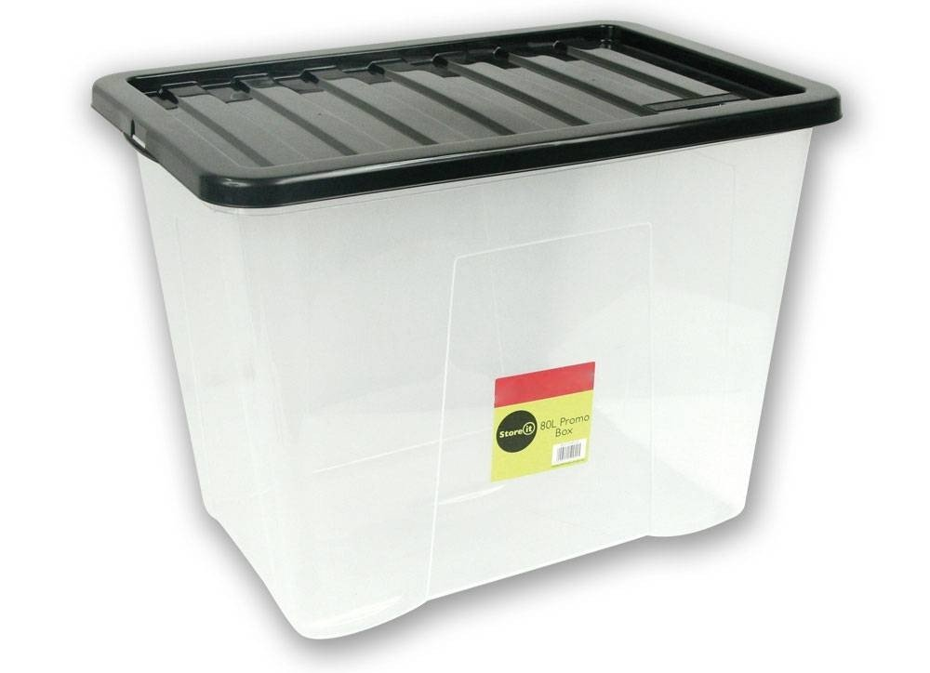
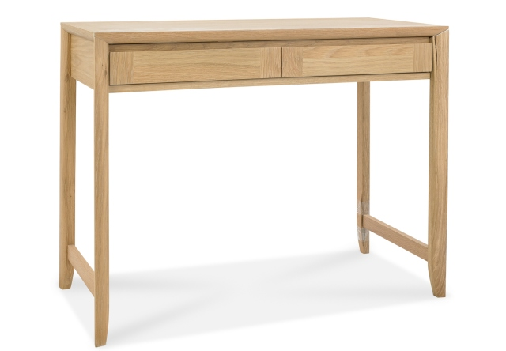
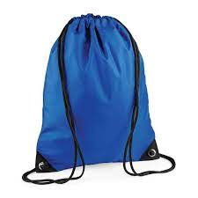
St. Gregory's
Catholic
High School
HOMEWORK
Your child will be given a homework timetable which is recorded in the back of the Student Handbook.
The homework will be posted on the Homework App
Initially, spend time helping your child organise and complete their homework on the day it is set so that an efficient routine is established
The LRC is open for an hour before and after school

Slide 10
St. Gregory's
Catholic
High School

Slide 11
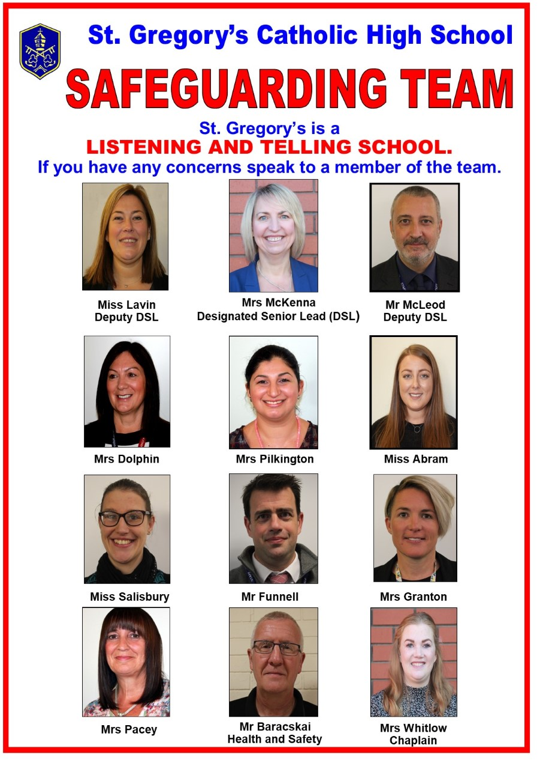
Safeguarding
your child
St. Gregory's
Catholic
High School
Pupil mobile phones should remain switched off throughout the day

Slide 12
St. Gregory's
Catholic
High School
Pastoral Support within school
Form tutor
Pastoral Support Manager
Pupil Progress Manager
Safeguarding Team (Family liaison officer, Mental health officer)
Chaplain
Attendance Officer and Mentor
Deputy Headteacher

Slide 13
St. Gregory's
Catholic
High School
Pastoral Support within school
PPM – Mr Wiles – rwiles@stgregoryshigh.com
PSM – Miss Dolphin – jdolphin@stgregoryshigh.com
Campion – Mrs Kaye/Mrs Krusinskyte
Fisher – Mr Glover
Julian – Mr Parry
Kolbe – Miss Sanderson
More – Mr Johnson
Plessington – Mr McMorine
Teresa – Ms Garcia
Winefride – Miss Clare

Slide 14
St. Gregory's
Catholic
High School
ONLINE SAFETY
How to keep your child safe online
National Online
Safety App
Webinars
Guides
Courses
E-safety Guides for Schools | National Online Safety

Slide 15
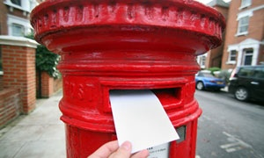
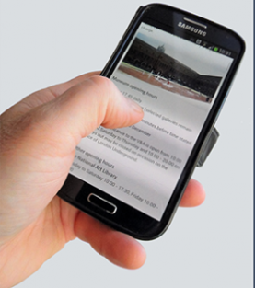
St. Gregory's
Catholic
High School
COMMUNICATIONS
School Comms – text/email
SIMS Parent App - information on attendance; behaviour and rewards; messages; school reports; update your information
Pupil Handbook – notes to form teacher and/or teaching staff
If you have concerns and wish to arrange a meeting, please contact the school

Slide 16
St. Gregory's
Catholic
High School
COMMUNICATIONS
School will contact parents
Phone calls
Letters home with pupils (available on school website)
Texting service (remember to tell school if your mobile number changes)
Information on the school website
Communication though the SIMs App
Class Charts announcements
www.stgregoryshigh.com

Slide 17
St. Gregory's
Catholic
High School
COMMUNICATIONS
Apps that you will need
SIMs app – attendance, behaviour, reports, your contact details
Pay 360 app – lunches and trips (linked to the SIMs app)
Class Charts app - homework

Slide 18
St. Gregory's
Catholic
High School
Settling In
There will be lots of new rules and procedures that pupils will need to get used to. Staff will support your child through this transition.
Incorrect footwear
Lost Ties
Lost PE Kits
Mobile phone use
Friendship Issues

Slide 19
St. Gregory's
Catholic
High School
Transition Day 1
8.45-9.10 – Pupils arrive and are directed to the Drama Theatre
9.10-9.30 – Collective Worship
9.30 – 10.30 – Form time
10.30 - 11.30 – Lesson 1
11.30 - 12.15 – Lunch
12.15 - 1.15 – Lesson 2
1.15 – 2.15 –Lesson 3
2.15 – 2.30 – Drama Theatre and dismissal

Slide 20
St. Gregory's
Catholic
High School
Transition Day 2
8.45-9.10 – Pupils arrive and are directed to the Drama Theatre
9.10-10.15 – Time with form tutor
10.15 – 10.45 – Break time
10.45 - 11.30 – PSHE lesson
11.30 - 12.15 – Lunch
12.15 – 12.30 – Line up on back yard and go to form
12.30-2.00 – Maths/PE challenge
2.00 – 2.15 – Back to form
2.15 - 2.45 – Drama Theatre and home

