Slide 1
INSET 2021/22
St Gregory’s High School
Statutory Safeguard Training

Slide 2
Our responsibilities under
Keeping Children Safe
in Education part 1

Slide 3
Today we’ll learn
How safeguarding is at the heart of what we do
What the 4 main types of abuse are and how to spot them
Specific safeguarding issues to be aware of and how to spot them
How you can act in a child’s best interests

Slide 4

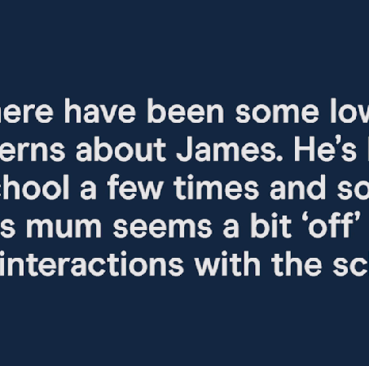


What would you do?
ACTIVITY
Time for activity: 1 minute
What to do: Write down what you’d do in this situation on page 1 of your activity pack
Click here to play the video

Slide 5

How safeguarding is at the heart of what we do
What the 4 main types of abuse are and how to spot them
Specific safeguarding issues to be aware of and how to spot them
How you can act in a child’s best interests

Slide 6
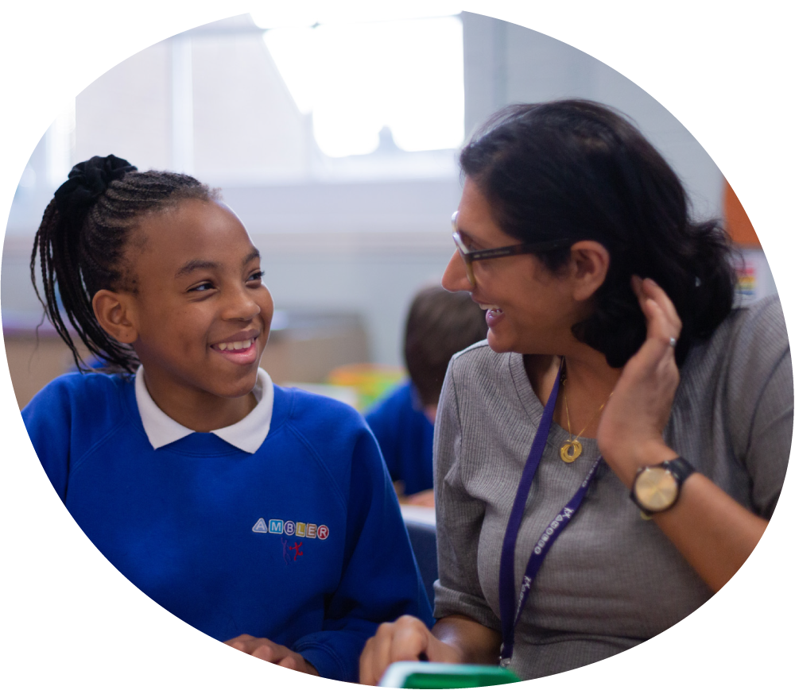
The 4 elements of safeguarding – What does this mean?
Protecting children from maltreatment
Preventing impairment of children’s mental and physical health or development
Making sure children grow up in circumstances consistent with the provision of safe and effective care
Taking action to enable all children to have the best outcomes

Slide 7

What changes to Keeping Children Safe in Education
mean for you?
Be aware that abuse can happen online, offline, or both
Be aware of the added vulnerability of children:
  With health conditions
  With mental health needs
  With a family member in prison or who are affected by parental offending
  Who are at risk of honour-based abuse (such as FGM or forced marriage)
  Who are persistently absent from school (including for part of the day)
Remember abuse can happen in relationships between children
Be aware of risk factors that increase the likelihood of involvement in serious violence
Be aware of child abduction and community safety incidents, modern slavery and cybercrime as safeguarding issues
Act immediately if you have concerns about sexual violence or harassment. If a child reports an incident, always take this seriously

Slide 8






Always assume ‘it could happen here’
For every child we know about, there are likely to be 8 more not getting the help they need
1 online offence against a child every 16 minutes

Slide 9




We all have a role to play in safeguarding children
The teacher’s information
The caretaker’s information
The office staff’s information
The midday supervisor’s information

Slide 10
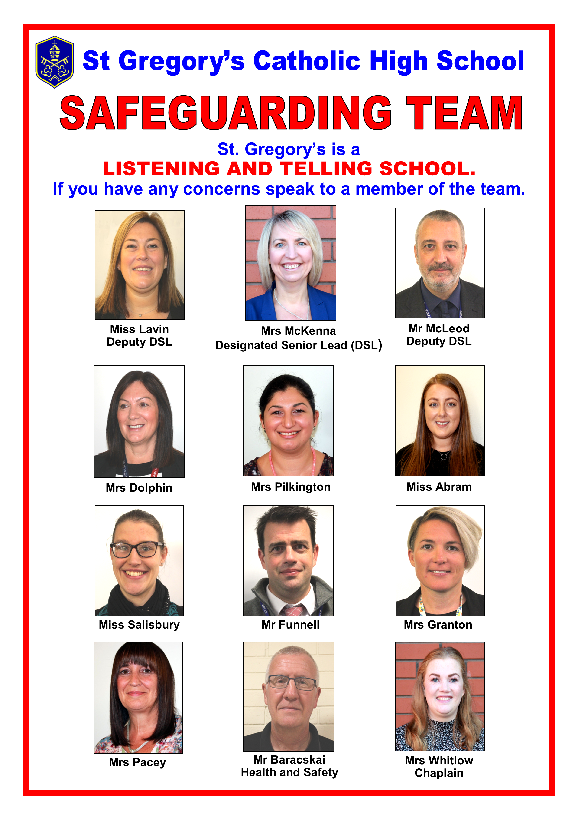
Here to listen:
St Gregory's
Safeguarding Team

Slide 11

Key points about the importance of safeguarding
Safeguarding means making sure children grow up safe, happy and healthy
Always assume ‘it could happen here’
We all have a role to play in safeguarding children
The safeguarding team are here to listen to any concerns you have
Be aware of what the changes to guidance mean for you

Slide 12
How safeguarding is at the heart of what we do
What the 4 main types of abuse are and how to spot them
Specific safeguarding issues to be aware of and how to spot them
How you can act in a child’s best interests

Slide 13

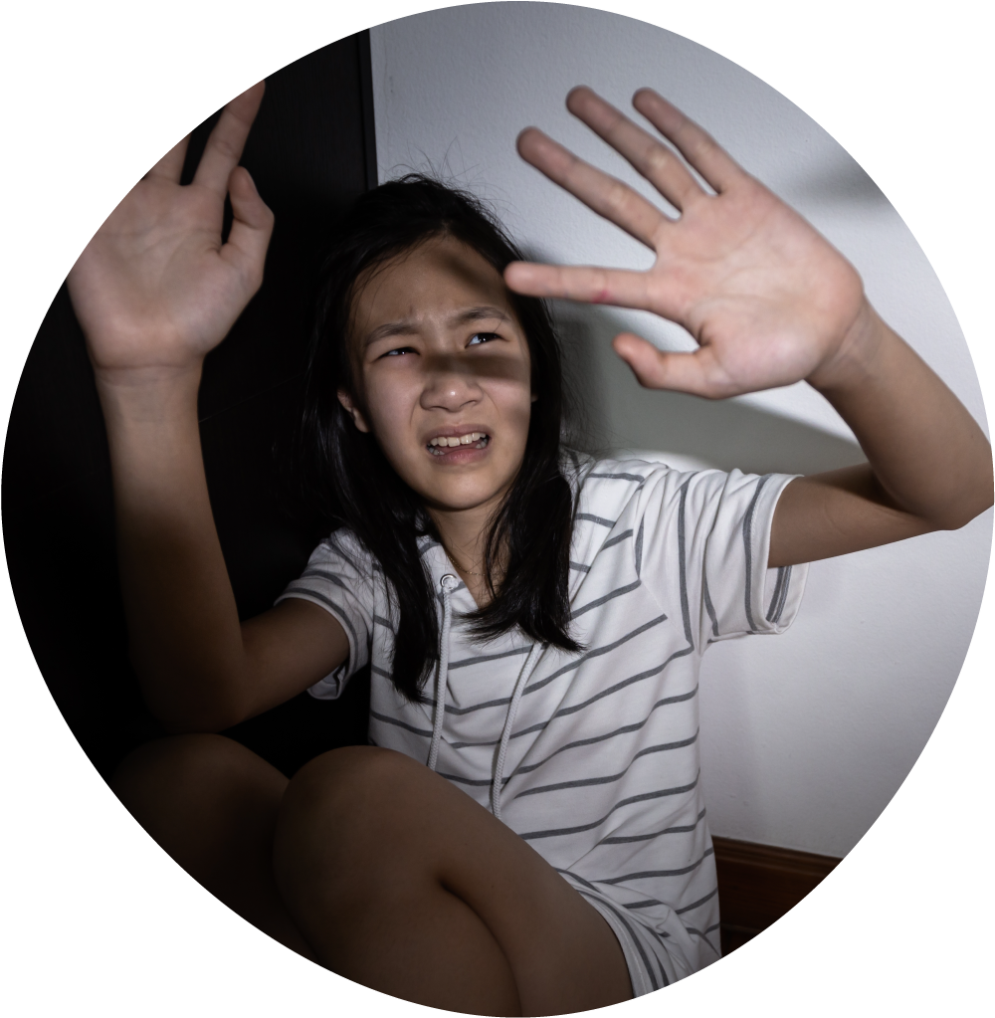

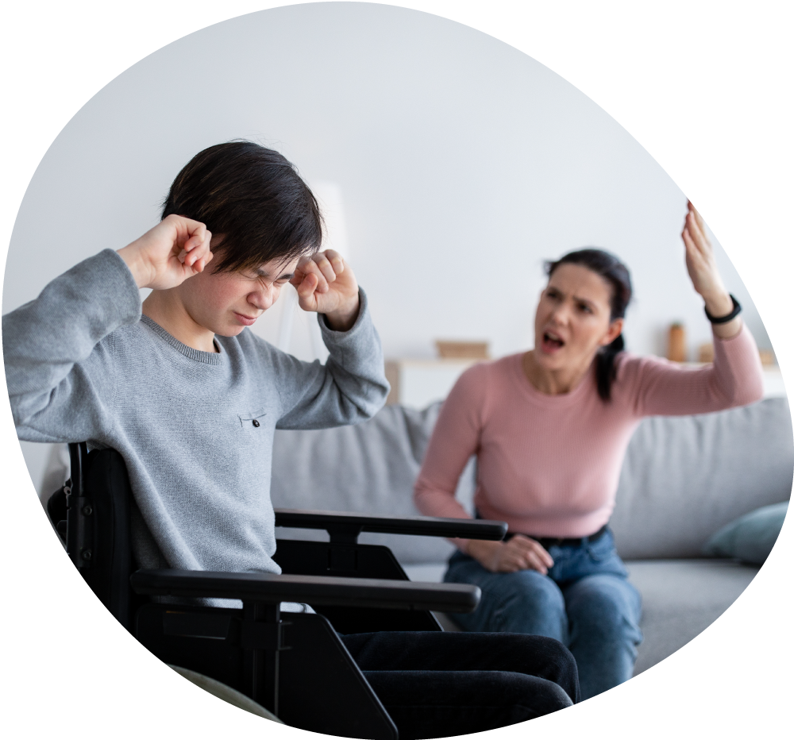
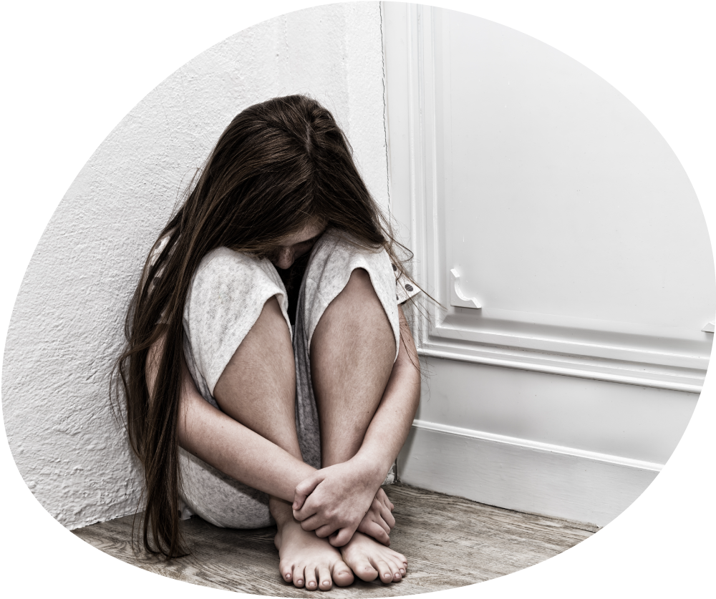
First, a quick reminder
What are the 4 main types of abuse?
Physical abuse
Sexual abuse
Emotional abuse
Neglect

Slide 14
Common behavioural signs to look out for, whatever the issue
Difficulty concentrating and not doing as well at school
Mood or behaviour changes
Becoming withdrawn
Tiredness
Mental health needs
Risk-taking behaviour
Using drugs or alcohol
Self-harming

Slide 15
Physical abuse: what you might see in children
Bruises, cuts, scratches, scars
Burns or scalds
Fractures
Bite marks
Vomiting, drowsiness or seizures
Suspicious illnesses
Breathing problems

Slide 16
Sexual abuse: what you might see in children
Marks and bruises
Poor personal hygiene
Needing the toilet a lot
Difficulty sitting
Fear or avoidance of a particular person
Sexually inappropriate behaviour
Dropping hints or mentioning ‘secrets’
Pregnancy

Slide 17
Emotional abuse: what you might see in children
Behaviour, language or knowledge you wouldn’t expect for their age
Struggling to control their emotions
Seeming isolated from their parents or carers
Negative interactions with parents or carers
Low self-esteem or self-confidence
Not caring how they act or what happens to them
Issues with language development
Lacking social skills or friends
Trying to make people dislike them

Slide 18
Neglect: what you might see in children
Severe and persistent illnesses and infections
Consistently inappropriate clothing or shoes
Persistently smelly or dirty
Signs of malnutrition
Being hungry, stealing or hiding food
Numerous accidents
Poor medical and dental care
Missing school

Slide 19

Could you spot abuse here?
ACTIVITY
Time for activity: 5 minutes
What to do
Read your group’s scenario (on page 1 of your activity pack)
Discuss whether there are signs of abuse, and if so, what kind
Write down your thoughts on page 2 of your activity pack
Refer to the list of indicators on pages 2 and 3 of your activity pack if you need to
If you have time, look at the other scenarios too

Slide 20
Did you spot the signs?
Amelia:
Signs of possible neglect
Antoni:
Signs of possible emotional abuse
Joshua:
Signs of possible sexual abuse
Haniya:
Signs of possible physical abuse

Slide 21
Key points about the 4 main types of abuse
The 4 main types of abuse are physical, sexual, emotional and neglect
Many of the signs overlap, but the crucial point is to be able to spot that something is wrong
Look out for changes in a child, for example in their mood, behaviour or appearance

Slide 22
How safeguarding is at the heart of what we do
What the 4 main types of abuse are and how to spot them
Specific safeguarding issues to be aware of and how to spot them
How you can act in a child’s best interests

Slide 23
Do you know your safeguarding issues?
Bullying, including cyber-bullying
Child abduction and community safety issues
Children and the court system
Child criminal and sexual exploitation
Children missing education
Children missing from home or care
Children with family members in prison
Domestic abuse
Drugs
Fabricated or induced illness
Faith-based abuse
Homelessness
Honour-based abuse
Mental health
Modern slavery
Online safety and cybercrime
Peer-on-peer abuse
Private fostering
Radicalisation
Serious violence

Slide 24
Test your knowledge of specific safeguarding issues
ACTIVITY
Time for activity: 2 minutes
On page 4 of your activity pack, match the following to their definitions:
Female genital mutilation
Child criminal exploitation
Child sexual exploitation
Peer-on-peer abuse
Mental health
Radicalisation
Online safety
Children missing education
Child abduction and community safety incidents

Slide 25
Children’s mental health is part of safeguarding
Signs you might see in a child:
Changes in behaviour, emotions or school performance
Less interest in things they usually enjoy
Physical signs
Not developing as well as they were previously
Low mood, tearfulness, low self-esteem
Being more socially isolated

Slide 26
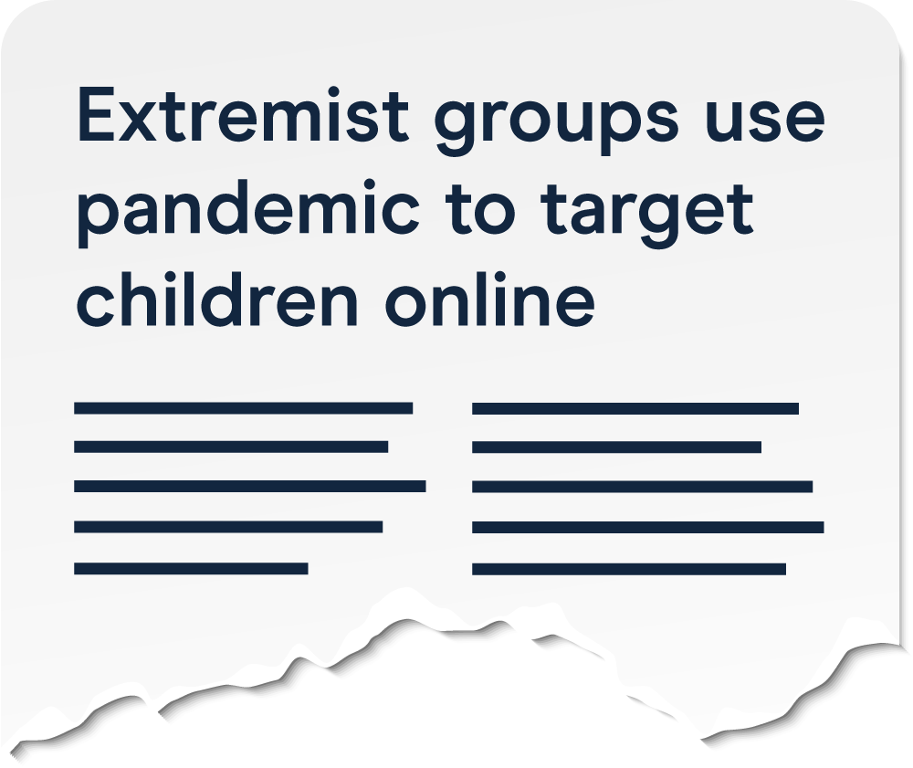
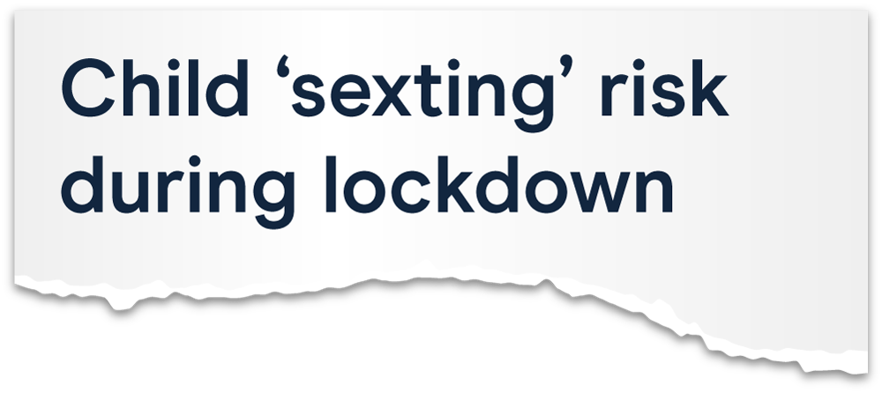
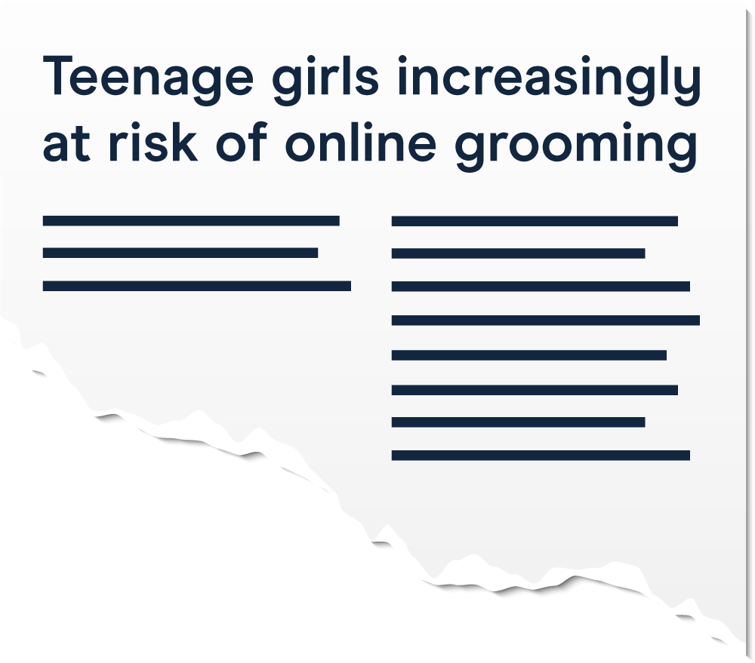

We still have responsibility for safeguarding issues online

Slide 27





Do you know your apps and games?
TikTok
Snapchat
Twitch
Minecraft
Roblox
Remember the 4 Cs: content, contact, conduct, commerce

Slide 28
Could you help prevent a child being drawn into terrorism?
In 2019/20, what percentage of Channel cases do you think were related to right-wing radicalisation?
(Channel is the programme that works with people who have been identified as being vulnerable to being drawn into terrorism)
Answer: 43%

Slide 29
Could you help prevent a child being drawn into terrorism?
Be on the lookout for children:
Isolating themselves from friends and family
Being unwilling or unable to discuss their views
Being more angry
Having a sudden disrespectful attitude towards others
Being more secretive, particularly around internet use
Talking as if from a scripted speech

Slide 30
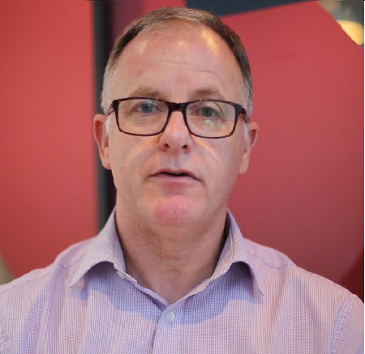
Child sexual exploitation (CSE): it might look consensual, but it isn’t
Click here to play the video

Slide 31
CSE: it might look consensual, but it isn’t
A child might:
Show unhealthy or inappropriate sexual behaviour
Have an older boyfriend or girlfriend
Show changes in mood or character
Be secretive
Suddenly have money or new possessions
Be frightened of some people, places or situations
Show signs of physical abuse
Misuse drugs
or alcohol
Have sexually transmitted infections
Get pregnant

Slide 32
Child criminal exploitation (CCE): children are still victims
A child might:
Miss school more, including single lessons
Have different friends, including older friends
Have unexplained gifts or new possessions
Have a significant change in wellbeing
Show signs of
self-harm
Have physical injuries
Not do as well at school
Misuse drugs or alcohol

Slide 33
Peer-on-peer abuse: children can abuse other children too
What forms might peer-on-peer abuse take?
Bullying
Abuse in intimate personal relationships
Physical abuse
Sexual violence
Sexual harassment
Causing someone to engage in sexual activity without consent
Sharing nudes or semi-nudes
Upskirting
Initiation or hazing-type violence and rituals
Always take immediate action if you have concerns or a pupil makes a disclosure
Notes:
be about how to act
Sources:
GOV.UK – DfE, Keeping Children Safe in Education. https://www.gov.uk/government/publications/keeping-children-safe-in-education--2
NSPCC, Protecting children from harmful sexual behaviour. https://learning.nspcc.org.uk/child-abuse-and-neglect/harmful-sexual-behaviour

Slide 34
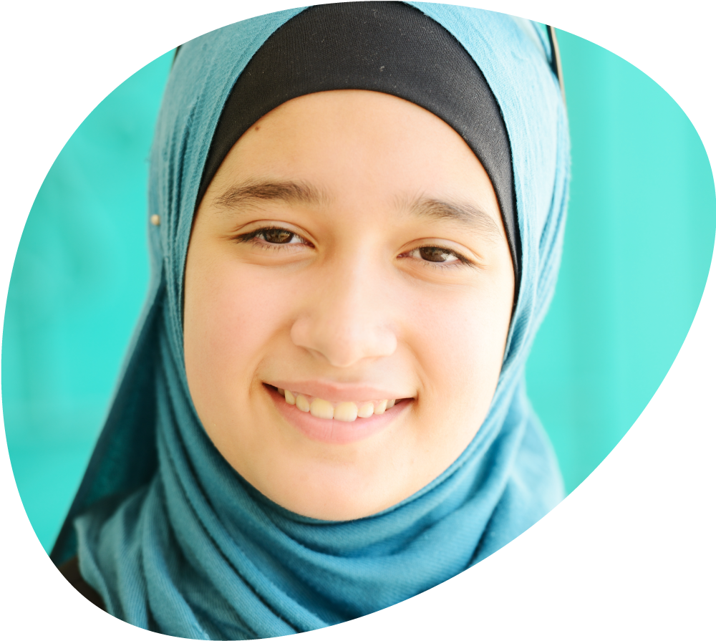
FGM: how to spot that a child is at risk
Signs Zahra is at risk:
Family or community history of FGM
Being withdrawn from PSHE education or RSE
Mentioning a long holiday to a country where FGM is prevalent
Mentioning a ‘special procedure’ or a ‘special occasion’ to become a woman
A request for a long absence from school or being unexpectedly absent
Notes:
Briefly remind staff that FGM is deliberate cutting, injury or change to female genitals, for no medical reason
Emphasise that FGM is child abuse – there’s no justification for it. It’s illegal in the UK, whether it happens here or abroad. Explain:
It can happen for cultural, religious and social reasons. It’s mostly been documented in Africa, as well as in the Middle East and Asia
FGM is a form of honour-based abuse, where crimes are committed to protect or defend the honour of the family or community. Other types of honour-based abuse include forced marriage, and breast ironing or flattening, where breasts are ‘ironed’ or flattened down over a period of time to make them disappear or delay their development
Families might believe FGM is beneficial to the girl or in her best interests, but there are no benefits to it, and it can cause serious harm, like pain, infections, bleeding, urinary problems, mental health problems, and later problems with sex and pregnancy
Explain that you’re going to look at some of the main signs that a girl is at risk of FGM
Ask staff to imagine a pupil called Zahra. Click to bring up each sign in turn, and explain how these might look in practice:
Zahra’s family are from Egypt, where FGM is common
They’ve withdrawn her from PSHE education
She’s said she’s going to Egypt in the holidays for a ‘special occasion’ to become a woman
Her parents have asked for some extra time off around this holiday
Remind staff that if they have any concerns about FGM (or other forms of honour-based abuse) they should take immediate action, following your school’s policies and procedures
Sources:
GOV.UK – DfE, Keeping Children Safe in Education. https://www.gov.uk/government/publications/keeping-children-safe-in-education--2
National FGM Centre, Breast flattening. http://nationalfgmcentre.org.uk/breast-flattening/
National FGM Centre, Female genital mutilation. http://nationalfgmcentre.org.uk/fgm/
NHS, Overview: Female genital mutilation (FGM). https://www.nhs.uk/conditions/female-genital-mutilation-fgm/

Slide 35
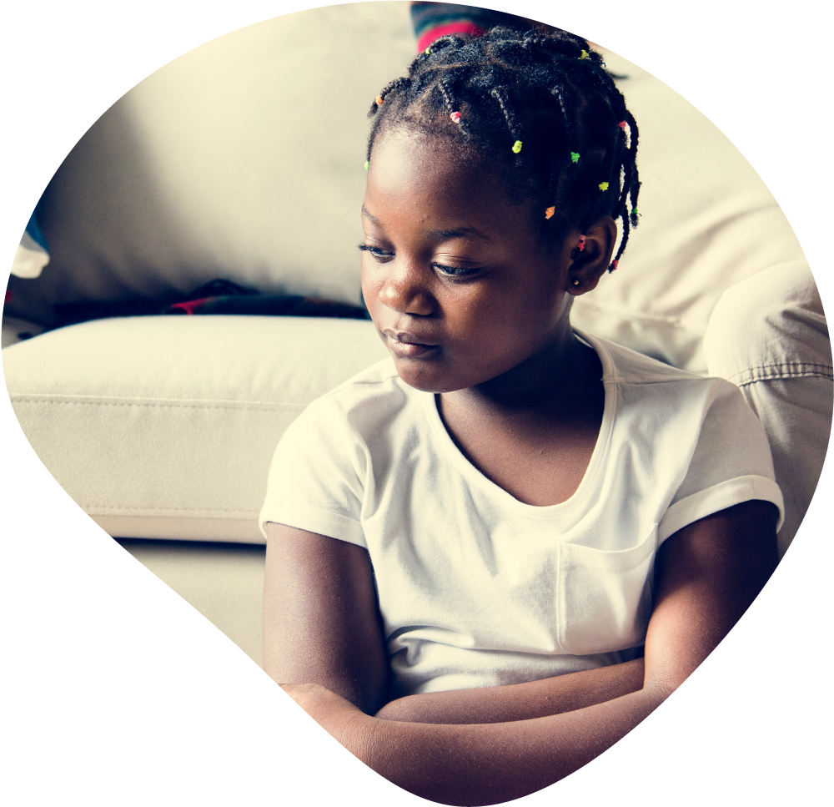
FGM: summer is the highest-risk time
Signs a girl is a victim of FGM:
Asking for help or confiding that it’s happened
Difficulty walking, sitting or standing
Looking uncomfortable or finding it hard to sit still
Prolonged or repeated absence
Change in behaviour or mood
Talking about pain or discomfort between her legs
Spending more time in the toilet
Avoiding PE or exercise
Frequent urinary, menstrual or stomach problems
Notes:
Remind teachers that they have a statutory duty to report known cases of FGM on a girl under 18 personally to the police. It’s not enough to report it to the DSL, they must report it directly to the police as well
For other staff, they might not have a specific statutory reporting duty, but they still have a duty to report concerns or cases, as part of their safeguarding responsibilities
Teachers are unlikely to see visual evidence, and should not examine pupils, but a girl might disclose that it’s happened
Click to bring up the points on the slide. Note that these are some of the main signs that a pupil is a victim of FGM
Explain that holidays, in particular summer holidays, are the highest-risk time for female genital mutilation. This is because holidays allow more time for girls to ‘heal’ before they come back to school
FGM often involves taking a girl abroad for it to happen. Although there might be less international travel this year, it can and does happen in the UK too
As the new school year starts, it’s therefore particularly important to be on the lookout for signs a girl has been a victim
Even if FGM has already happened, your school can still help the girl get support to deal with the physical and emotional effects of it
Sources:
GOV.UK – Home Office and DfE, Mandatory reporting of female genital mutilation: procedural information. https://www.gov.uk/government/publications/mandatory-reporting-of-female-genital-mutilation-procedural-information
GOV.UK – Home Office, DfE and Department of Health and Social Care, Multi-agency statutory guidance on FGM. https://www.gov.uk/government/publications/multi-agency-statutory-guidance-on-female-genital-mutilation
National FGM Centre, Female genital mutilation. http://nationalfgmcentre.org.uk/fgm/
NHS, Overview: Female genital mutilation (FGM). https://www.nhs.uk/conditions/female-genital-mutilation-fgm/

Slide 36
Key points about specific safeguarding issues
To effectively safeguard children, you need to know about safeguarding issues beyond the 4 main types of abuse
Even if it happens outside the school or family, it’s still part of safeguarding
Some abuse might appear to be consensual, but children are still victims
Know the signs, but be particularly alert to changes in a child
Notes:
Ask staff: what are the key points to take away about specific safeguarding issues?
Take 1 or 2 suggestions, then click to bring up the points on the slide
Give staff a minute to read these key points
Ask if they have any questions about what you’ve covered in this section, and take questions

Slide 37
How safeguarding is at the heart of what we do
What the 4 main types of abuse are and how to spot them
Specific safeguarding issues to be aware of and how to spot them
How you can act in a child’s best interests

Slide 38
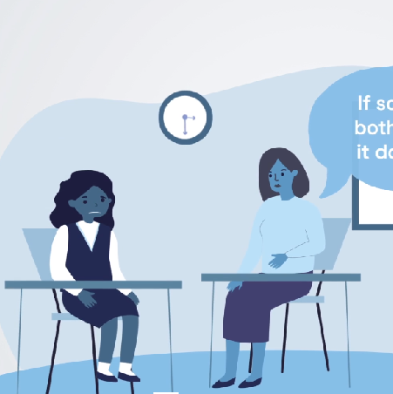
Let’s watch: Binita’s disclosure
Watch: what does the adult do here?
Click here to play the video

Slide 39
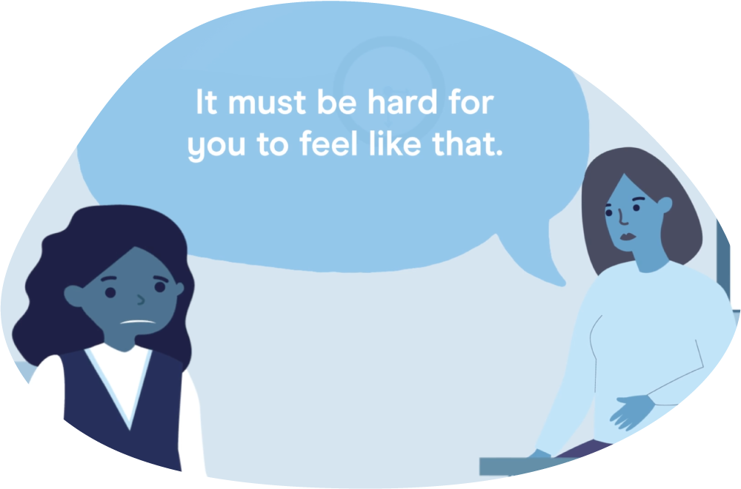
How you should respond to a disclosure
Listen fully, be supportive, take the child seriously
Let the child lead the conversation
Reassure the child it’s not their fault
Ask open questions, not closed or leading questions
Reflect back what they’re saying
Be honest that you can’t keep it confidential. Be clear about what you’ll do next
Don’t talk to the alleged abuser or investigate yourself

Slide 40
Indirect disclosures: what might a child do?
Communicate through their behaviour
Make ambiguous verbal statements
Communicate non-verbally
Bobby says “I don’t like sleeping over there because granddad snores”
Binita was quieter than usual
Jessica draws lots of pictures of angry people

Slide 41
Binita’s disclosure: what can you remember?
ACTIVITY
Time for activity: 2 minutes
What to do: Write down what you remember about Binita’s disclosure on page 6 of your activity pack

Slide 42

Binita’s disclosure: what can you remember?
Report made: 4pm, 7 October 2021
At 3.30pm on 7 October 2021, in the classroom, I asked Binita S if anything was worrying her, as I’d noticed she seemed withdrawn and wasn’t doing as well at school.
Binita said it didn’t matter. I said that if something was bothering her, it did matter, and we could try to help if she told me.
Binita said “I want to live my own life but they don’t want me to”.
I asked who she meant, and she said her parents.
She said she wanted to be a good daughter but she wanted to live her own life.
I asked her what she meant. She said her parents said that in the holidays she needs to “go away to be married”. Binita said she doesn’t want to, but doesn’t want to make her parents sad.
I thanked her for telling me. Binita said she “wasn’t meant to tell anyone” and asked if I was going to tell anyone. I said I had to tell Mr Ali so he could decide what to do to help keep her safe, but I wouldn’t tell anyone who didn’t need to know.
Binita asked if she was going to get into trouble. I told her she was not, and I let her know she could come and talk to me if anything else was bothering her.

Slide 43

What a good safeguarding report looks like
A good safeguarding report:
Is made immediately after the disclosure or incident
Includes the date and time, who was there, and where it happened
Describes what happened in as much detail as possible
Is fact based, with no personal interpretation
Includes the child’s words, where possible
Think: who, what, where, when

Slide 44
Always report any concerns you have
You have a concern / a child makes a disclosure
The DSL decides what to do next
No immediate
further action
You report it
Early help
Referral to
children’s social care
ALL safeguarding concerns should be reported to myself or a member of the Safeguarding Team using a purple form as soon as possible, DO NOT leave it until the end of the day

Slide 45

If a child is in immediate danger, take action immediately
Contact children’s social care:
01925 443400
And, if appropriate, the police:
084584580000 or 999

Slide 46
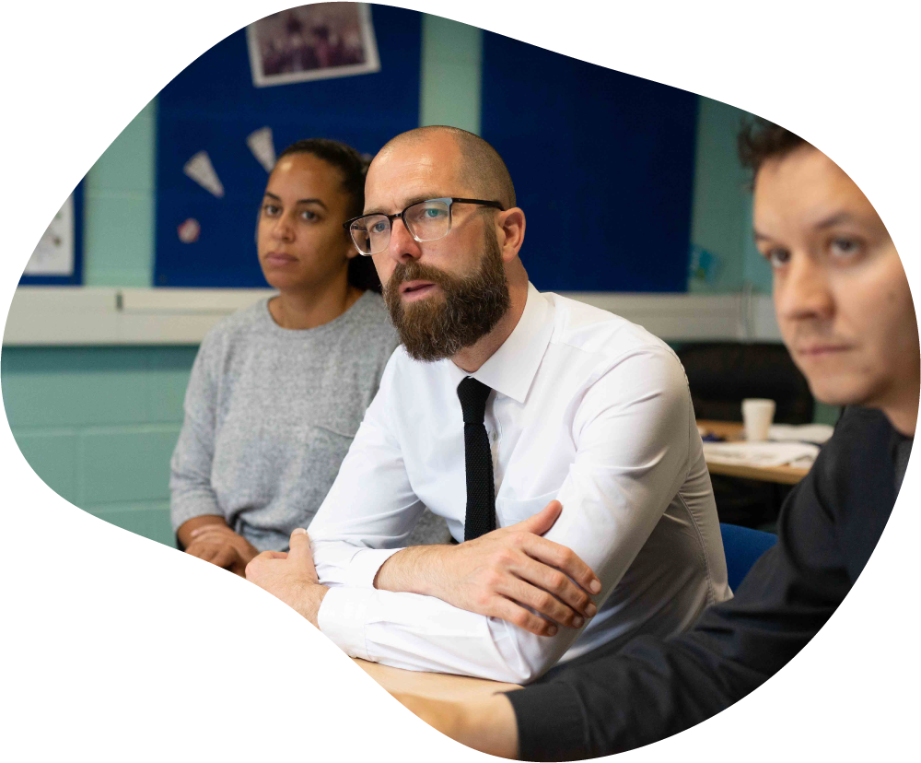
How to report concerns you have about staff
If you have concerns about:
A member of staff or volunteer, speak to the headteacher
The headteacher, speak to the chair of governors
Mr R Harrison

Slide 47

How to report concerns about
our safeguarding practice
Speak to DSL face to face/via email. Escalate your concern to Mr McGlinchey or the Chair of Governors – follow the Whistleblowing policy if you’re not satisfied.
Otherwise, use the NSPCC helpline on:
0800 028 0285 (8am to 8pm, Monday to Friday)
help@nspcc.org.uk

Slide 48
Key points about how to act in a child’s best interests
Take a child seriously if they make a disclosure
Be alert to indirect disclosures
Don’t promise confidentiality. Let the child know what you’re going to do next
Always report any concern you have, no matter how small
Always make a report as soon as possible
If you think a child is in immediate danger, make a referral yourself, or call the police

Slide 49
Key takeaways about our responsibilities under Keeping Children Safe in Education part 1
Always assume ‘it could happen here’
Always act in the child’s best interests
Be on the lookout for signs of abuse, and in particular for changes in a child
If you see something, say something – always report any concerns and keep written records

